Slide 1
Stakeholder Engagement in Research Priority setting
The three of us jumped out of plane at the same time but we positioned ourselves differently so we ended up at variable heights at the end.
There are decisions that we make to prioritise research questions in a certain order, however, there are contextual factors, people’s value and commitments and resources that can change which questions becomes a more important priority overtime.

Slide 3
Who to involve?
It will be useful to ask yourself these questions
What is the objective of the priority setting exercise?
What are the strategic objectives, values and principles of the group or organization that supports, commission or intends to use the research priority setting exercise
What are the priorities, objectives and values those sponsoring the priority setting exercise?

Slide 4
Do you have any partnerships or relation with any of the stakeholders?
If there are several stakeholders, are there any potential of conflicts?
How do you manage conflict of interest in the process?

Slide 5
Who is involved at what stage of the priority setting exercise??

Slide 6
Objective/
Scope
Identify Qs
Building partnerships
Define criteria
Information management
Identify questions/topics
Ranking questions/topics
Reaching consensus
Getting priorities to research
Evaluation

Slide 7
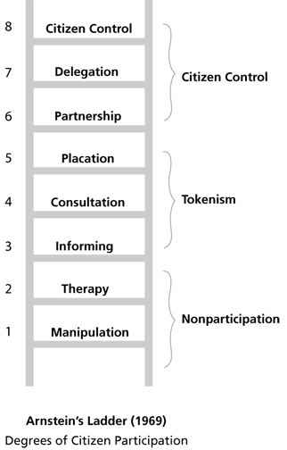
How much do you want to involve them?

Slide 8
Methods Selection

Slide 9
Controversial topic Unexplored topic
Controversial topic well-discussed topic
Using more interviews and focus groups
Acceptable to use surveys and similar approaches

Slide 10
The topics are potentially close together and there is lots of negative and positive sides can marginally make difference
The topics are clearly different and there is a general consensus in the community on differences
Agree on clear and transparent pre-defined criteria that can differentiate between topics
It is acceptable to not have pre-defined criteria and maybe collect information on how people made decisions

Slide 11
How do you ensure that they are interested in the process and feel ownership towards the exercise to engage in it? Does it require certain adaptation in the methodology?

Slide 12
