Slide 1
THE GLOBAL BURDEN OF DISEASE IN RESEARCH PRIORITIZATION
Chante Karimkhani
Columbia University, MSIV
PI: Robert Dellavalle, MD, PhD, MSPH
University of Colorado and Denver VA Medical Center

Slide 2
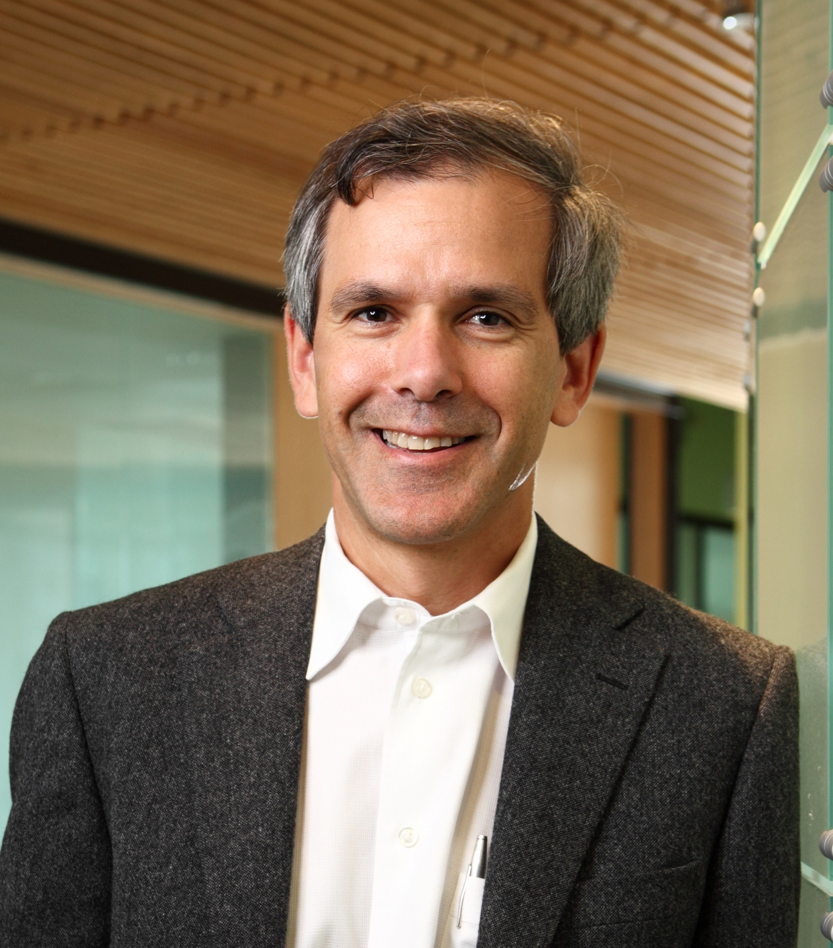

Slide 3
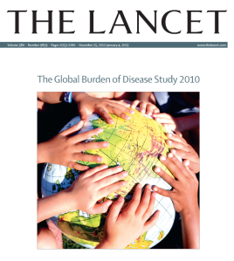

Slide 8
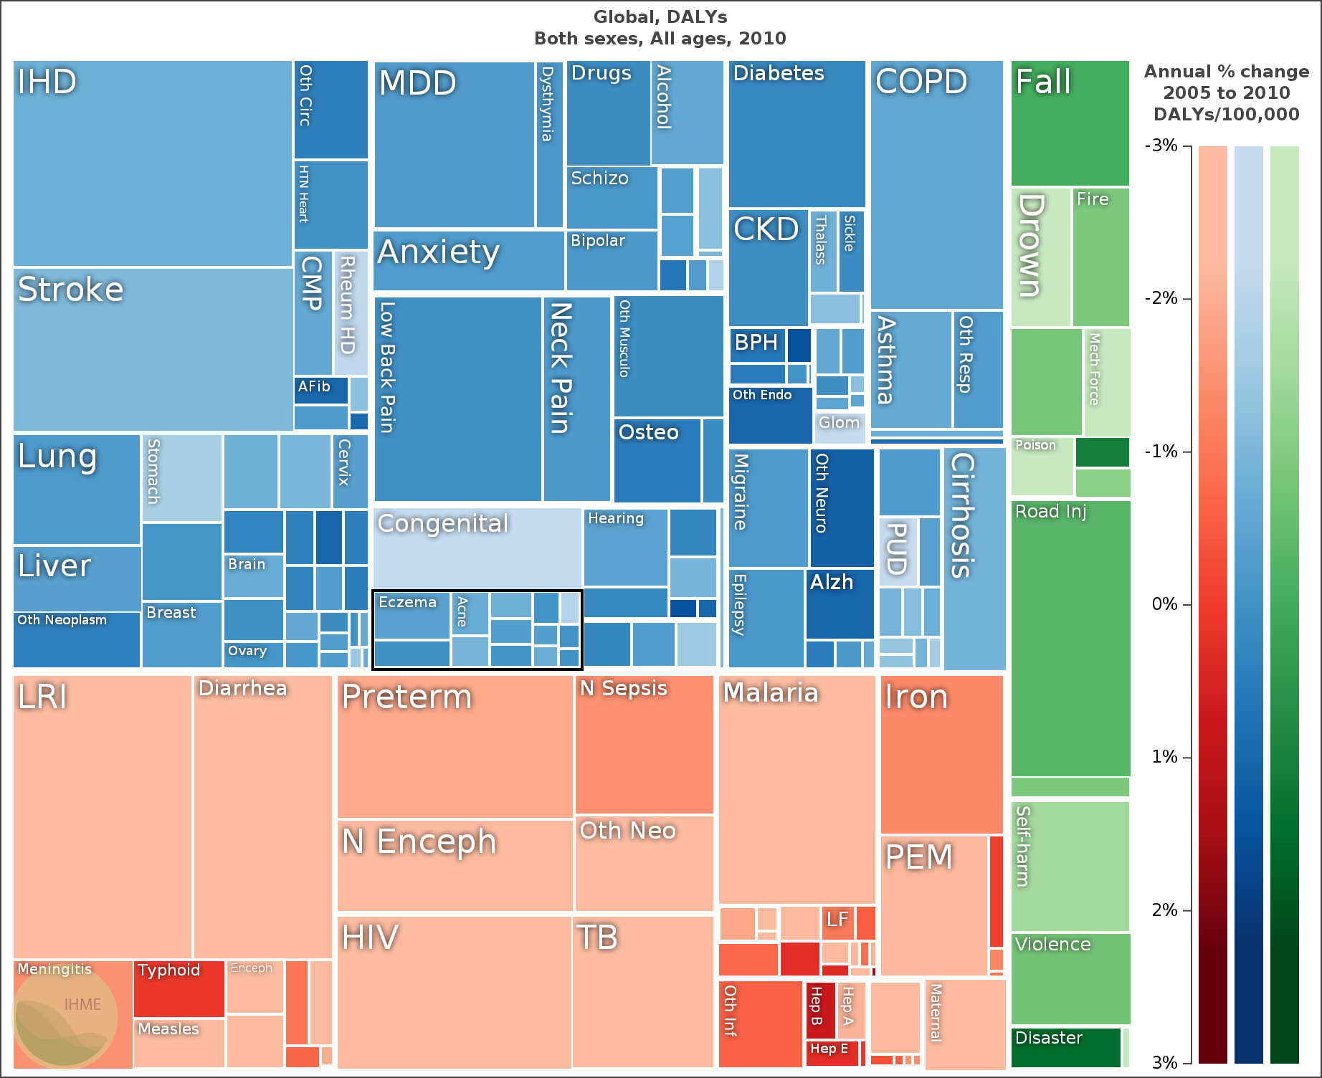
GLOBAL DALYS: ALL CONDITIONS 2010

Slide 9
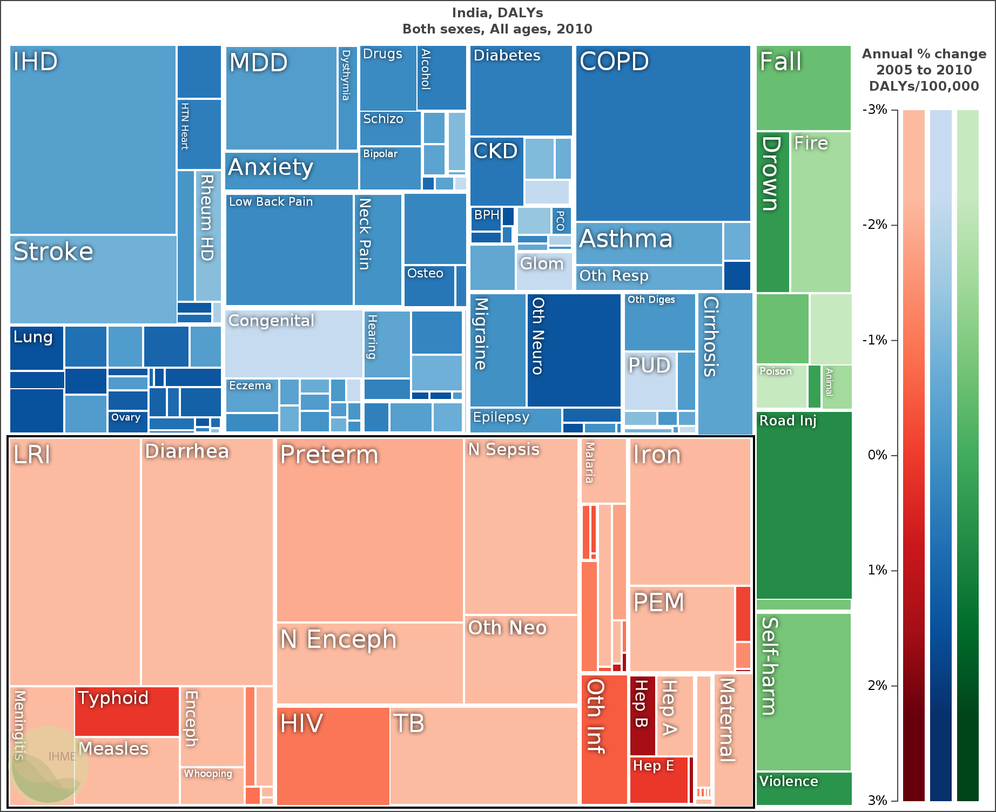
INDIA DALYS: ALL CONDITIONS 2010

Slide 11
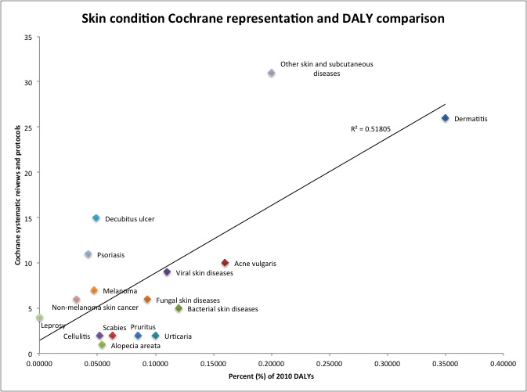
Skin condition Cochrane representation and DALY comparison
Karimkhani, et al. Global Burden of Skin Disease in 2010 and Skin Disease Systematic Reviews and Protocols in The Cochrane Database of Systematic Reviews. JAMA Dermatol. 150(9):945-51

Slide 12
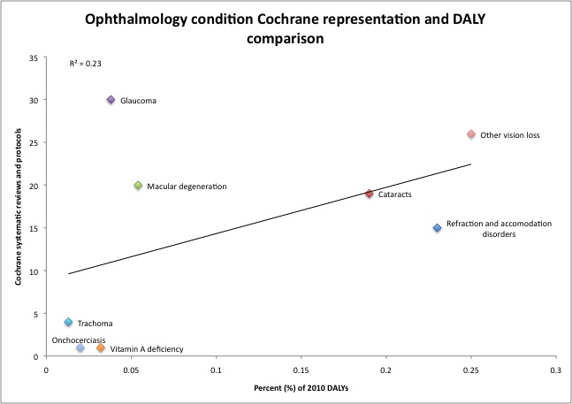
Ophthalmology condition Cochrane representation and DALY comparison
R²=0.23
Boyers, et al. Global burden of eye and vision diseases in 2010 and systematic reviews and protocols in Cochrane Database of Systematic Reviews. JAMA Ophthalmol. 2014. doi: 10.1001/jamaopthalmol.2014.3527. [Epub ahead of print]

Slide 13
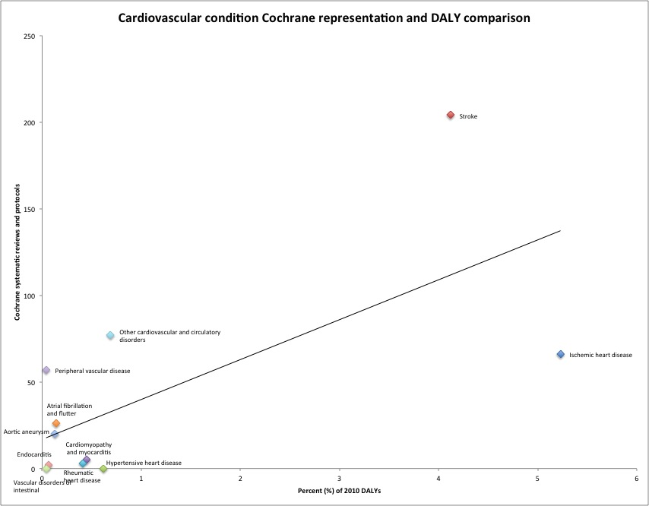
Cardiovascular condition Cochrane representation and DALY comparison
Aksut, et al. Identifying systematic review research gaps in cardiology. JACC. [submitted]

Slide 14
Hagstrom, et al. An analysis of cutaneous research funded by the National Institutes of Health from 2012-2013 compared with respective disease burden. JAMA Dermatol. [submitted]
Karimkhani, et al. Comparing cutaneous research funded by the National Institute of Arthritis and Musculoskeletal and Skin Diseases with 2010 Global Burden of Disease results. PLOS ONE. 2014;9(7):e102122.

Slide 16
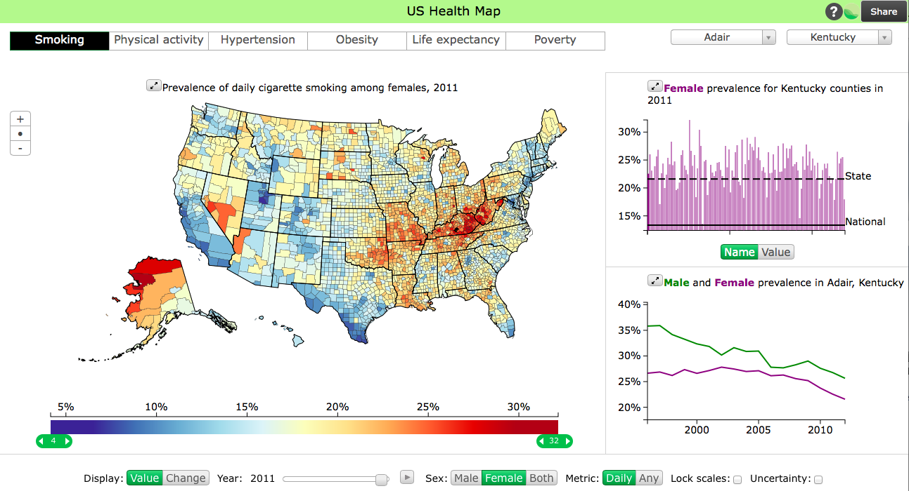

Slide 17
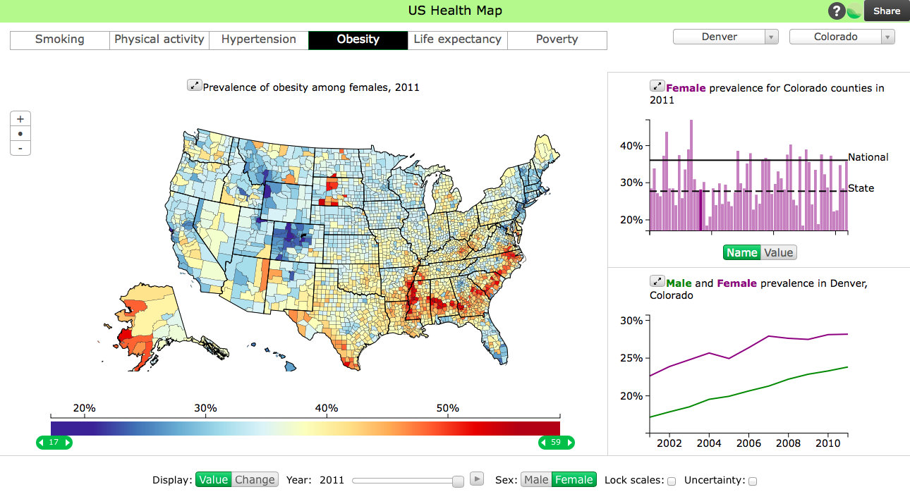

Slide 18
Disease burden
Equity
Cost
Interventions
Interest-group advocacy
Transmissibility
Public interest
Scientific innovation
Infrastructure

Slide 19
THANK YOU FOR YOUR TIME & ATTENTION!

