Slide 1
Perspective of different stakeholders in a research priority setting of a public health problem in LMIC
Special Session at 22nd Cochrane Colloquium 2014
Dr. Soumyadeep Bhaumik
BioMedical Genomics Centre, Kolkata, India
drsoumyadeepbhaumik@gmail.com
No Competing Interests & Not Funded

Slide 2
Agenda of Medicine…
‘We live in a world with infinite possibilities. Hearts are transplanted, DNA is decoded, and new medical discoveries are made every day. Yet we continue to be stymied by how best to reach those in resource-poor settings with the most basic care and medicines that we take for granted. What could break through this conundrum?’
Bill Frist & Richard Sezibera. The Lancet, 2009;374:1485-1486

Slide 3
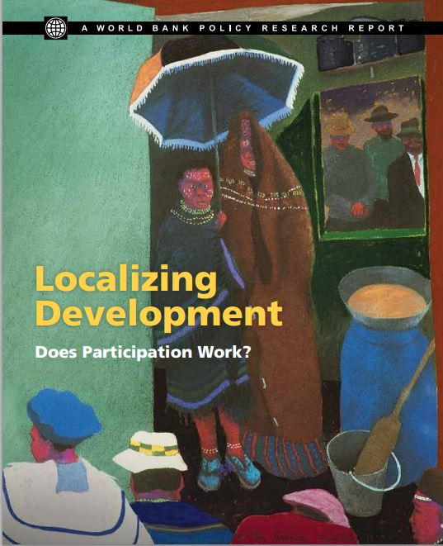
Barriers to patient involvement for research priority setting in LMICs
Low- and middle-income countries (LMICs) are now encouraging increased public participation in research priority setting.
Patient engagement in priority setting in LMICs has recently been included in the recent World Bank evaluation

Slide 4
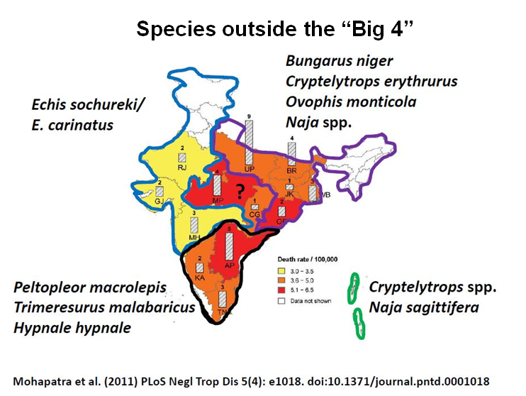
Anatomy of
Snake envenomation
as a public health problem
About 50,000 deaths annually
The key reason why snakebite is not a priority is that most victims lack political voice because they tend to be poor, children, and from rural areas.
“The global toxinology community remains concerned about the impact of toxin or venom based diseases on vulnerable populations, such as those in rural India, where we know from hard evidence that snakebite exerts a huge human toll”
BMJ 2013;346:f628 doi: 10.1136/bmj.f628 (Published 31 January 2013)

Slide 5
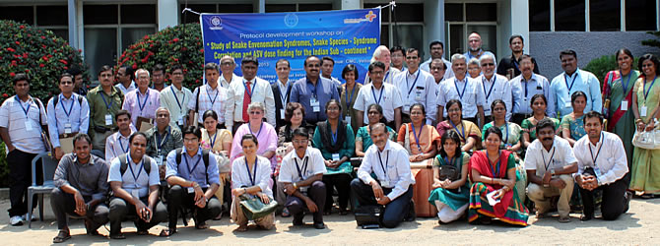
March 2013
40 participants attended the Protocol Development Workshop : National Snakebite Study with a range of expertise:
Clinicians , health workers and public health professionals from study hospitals and centers
Herpetologists
Members of the public and patient groups
Scientists involved in the snake venom detection technologies
Members from Anti-snake venom manufacturing companies
Software experts
External consultants from neighboring countries involved in snakebite research
http://cochrane-sacn.org/

Slide 6
Data from 17 Centres: Snake Anti-venom
Indications for Snake Anti-venom Administration
Varying indications and criteria used for local signs , neurotoxic/vasulotoxic signs and symptoms.
Snake Anti-venom Dosing:
Varying initial doses with some centres having a loading dose of 02 vials dissolved in 100ml NS over 30 minutes and some using 10 vials dissolved in NS in 1 hour.
Some centres used continuous infusion while others did not.
The limit of ceiling dose varied from as low as 08 vials to high as 50 vials.

Slide 7
Data from 17 Centers: Other treatment modalities
Different Indications and dosing for use of prophylactic medications ,neostigmine , and antibiotic usage.
Some centres do not use any prophylactic medications and some used inj. hydrocortisone while others inj. adrenaline.
Intensive care and referral to higher centre indications different across centres.

Slide 8
What were priorities of clinicians?
Whether to use Snake anti-venom (SAV)at all ?
What doses to use for SAV ?
What is protocol to use SAV ?
Can adverse effects of SAV be prevented ?
How to manage SAV adverse reaction ?

Slide 9
What were the priorities for public health professionals ?
Does these differences in protocol translate to different health outcomes in different regions ?
Are these differences in protocol reflective of different geographical snake species variation?
Why does no one adhere to “our” protocol?
Do we need to develop rapid diagnostic kits ?
Do we need to develop species-specific SAV?

Slide 11
What patients want…
Does a walking stick scare snakes at night ?
Does using torches help prevent snakebites?
What about interventions the “ojhas” or traditional faith healers provide?
“ I could not get my daughter married”
SAVs are in short and erratic supply in hospitals ? Doctors tell me to buy ?
There are no ventilators at primary health care centers.
Why is snakebite a medico-legal case ?

Slide 12
Barriers in patient involvement
Fear of health knowledge stigmatization
Tokenism
Can we reach the real stakeholders?
Improving health education status in general.
Lack of confidence
Knowledge about what science and research means

Slide 13
Thank You
drsoumyadeepbhaumik@gmail.com
DrSoumyadeepB
Slides to be available at: www.soumyadeepb.wordpress.com

