Slide 1


Kevin Pottie MD MClSc CCFP FCFP
Associate Professor, Departments of Family Medicine and Epidemiology and Community Medicine, University of Ottawa
Cochrane Equity Methods Group and GRADE Working Group,
WHO Guideline Review Committee
Priority Setting for Guidelines and Interventions

Slide 2
Background
Setting priorities is critical to ensure guidelines
are relevant and acceptable to users, and that time, resources and expertise are used cost-effectively in their development.
Stakeholder engagement and the use of an explicit procedure for developing recommendations are
critical components in this process.

Slide 3


\
Photo Credit: International Organization for Migration and WHO
3
Notes:
3

Slide 4
Where are the gaps in the health system ?
Why does it occur (risk factors)?
Is it important?
How do refugees differ from the Local population?
What health system interventions might be most relevant and most feasible ?
Could this be harmful for
refugees?
Does doing this cost more than that?
Will refugees use the
service?
If I do this here, what happens over there?
Will immigrants accept it?

Slide 5
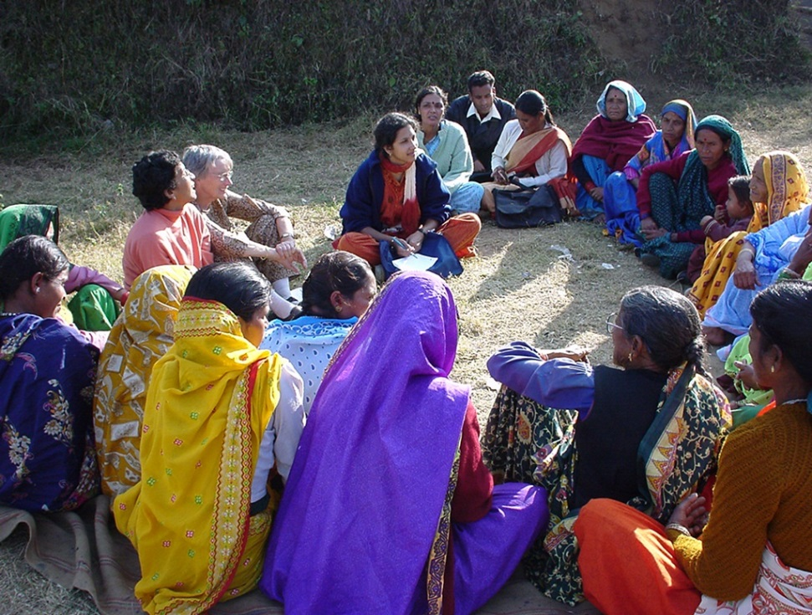
Priority Setting:
Delphi Selection Process
Importance
Usefulness
Disparity
(Oxman et al WHO priority setting 2006)
Notes:
The primary objectives - To identify and select priority preventable and treatable health conditions that confront immigrants and refugees during the first 5 years of the resettlement process

Slide 6

Priority Topics for Evidence Based Guidelines
Infectious Diseases
MMR/DPTP-HIB
Varicella (Chicken Pox)
Hepatitis B*
Tuberculosis*
HIV/ AIDS*
Hepatitis C
Intestinal Parasites*
Malaria
Mental Health and Maltreatment
Depression *
Post Traumatic Stress Disorder*
Child Maltreatment*
Intimate Partner Violence *
Other Chronic Disease
Diabetes*
Dental disease*
Contraception
Cervical Cervix/HPV
Iron Deficiency Anemia*
Vision Disorders
Pottie K, Greenaway C, Feightner J, et al . Evidence Based Clinical Guidelines for Immigrants and Refugees. CMAJ 2011
Notes:
The ones with asterisk are the ones that had 80% consensus after one round
Note the prominence of mental health concerns, but also dental made it into top 11
The list of top 20 conditions was reviewed and approved by the expert panel at the consensus conference: with one modification by the panel of key experts who would be developing the guidelines: Routine vaccine preventable diseases were considered a single priority, combining tetanus diphtheria and polio with MMR for guideline development.
Third round - As a final step, Delphi participants were sent the identified 20 conditions for approval and discussion; of the 41 participants, 88% approved (35/35 who participated in this round).

Slide 7

Delphi Process
Carefully select participants, you want a near 100% response rate
Importance of scoping reviews to inform and define initial list of conditions, more can be added
Value of priority criteria, sharing results on ranking, and role of 3-4 ranking sessions

Slide 8
Selection of Priorities for Guidelines
Preventable and treatable, but often-neglected, health
conditions were selected for the development of
guidelines for immigrant populations made vulnerable
because of health system bias.
Although infectious disease continues to be important,
mental health and chronic diseases have emerged as areas of concern in the care of recently arriving immigrants and refugees.

Slide 9
To identify and prioritize innovative strategies to address the health concerns of vulnerable migrants
language interpretation
comprehensive interdisciplinary care,
evidence-based guidelines*
training and mentorship for practitioners
intersectoral collaboration
immigrant community engagement*
93% response rate Pottie et al Can Fam Physician 2013

Slide 10
Rejecting and accepting international migrant patients into primary care practices
Mixed methods, Delphi + 10 interviews
Reasons to reject:
communication challenges, high hassle factor
fear of financial loss, limited knowledge of migrant medicine
Reasons to accept:
feeling useful, migrant health education, third party support, learning from other cultures, experience working overseas
            Moto et al. International J of Migration Health and Social Care -under review

Slide 11
Thank You!
Questions?

