Slide 1

Cochrane Diagnostic test accuracy reviews
Introduction to meta-analysis
Jon Deeks and Yemisi Takwoingi
Public Health, Epidemiology and Biostatistics
University of Birmingham, UK
Notes:
1

Slide 2
Outline
Analysis of a single study
Approach to data synthesis
Investigating heterogeneity
Test comparisons
RevMan 5

Slide 3
Test accuracy
What proportion of those with the disease does the test detect? (sensitivity)
What proportion of those without the disease get negative test results? (specificity)
Requires 2×2 table of index test vs reference standard

Slide 4
2x2 Table – sensitivity and specificity
 |  | Disease (Reference test)
 |  | Present | Absent
Index test | + | TP | FP | TP+FP
 | - | FN | TN | FN+TN
 |  | TP+FN | FP+TN | TP+FP+ FN+TN
sensitivity
TP / (TP+FN)
specificity
TN / (TN+FP)
Notes:
4

Slide 5
Heterogeneity in threshold within a study
diagnostic threshold

Slide 6
Heterogeneity in threshold within a study
diagnostic threshold

Slide 7
Heterogeneity in threshold within a study
diagnostic threshold

Slide 8
Heterogeneity in threshold within a study
diagnostic threshold

Slide 9
Heterogeneity in threshold within a study
diagnostic threshold

Slide 10
Heterogeneity in threshold within a study
diagnostic threshold

Slide 11
Threshold effect
Decreasing threshold decreases specificity but increases sensitivity
Increasing threshold decreases sensitivity but increases specificity

Slide 12
Ex.1 Distributions of measurements and ROC plot no difference, same spread
Uninformative test

Slide 13
Ex.2 Distributions of measurements and ROC plot small difference, same spread
line of symmetry

Slide 14
Diagnostic odds ratios
Ratio of the odds of positivity in the diseased to the odds of positivity in the non-diseased

Slide 15
Diagnostic odds ratios
 | Sensitivity
Specificity | 50% | 60% | 70% | 80% | 90% | 95% | 99%
50% | 1 | 2 | 2 | 4 | 9 | 19 | 99
60% | 2 | 2 | 4 | 6 | 14 | 29 | 149
70% | 2 | 4 | 5 | 9 | 21 | 44 | 231
80% | 4 | 6 | 9 | 16 | 36 | 76 | 396
90% | 9 | 14 | 21 | 36 | 81 | 171 | 891
95% | 19 | 29 | 44 | 76 | 171 | 361 | 1881
99% | 99 | 149 | 231 | 396 | 891 | 1881 | 9801

Slide 16
Symmetrical ROC curves and diagnostic odds ratios
As DOR increases, the ROC curve moves closer to its ideal position near the upper-left corner.

Slide 17
Asymmetrical ROC curve and diagnostic odds ratios
LOW DOR
HIGH DOR
ROC curve is asymmetric when test accuracy varies with threshold

Slide 18
Challenges
There are two summary statistics for each study –sensitivity and specificity – each have different implications
Heterogeneity is the norm – substantial variation in sensitivity and specificity are noted in most reviews
Threshold effects induce correlations between sensitivity and specificity and often seem to be present
  Thresholds can vary between studies
  The same threshold can imply different sensitivities and specificities in different groups

Slide 19
Approach for meta-analysis
Current statistical methods use a single estimate of sensitivity and specificity for each study
Estimate the underlying ROC curve based on studies analysing different thresholds
Analyses at specified threshold
  Estimate summary sensitivity and summary specificity
Compare ROC curves between tests
  Allows comparison unrestricted to a particular threshold

Slide 20
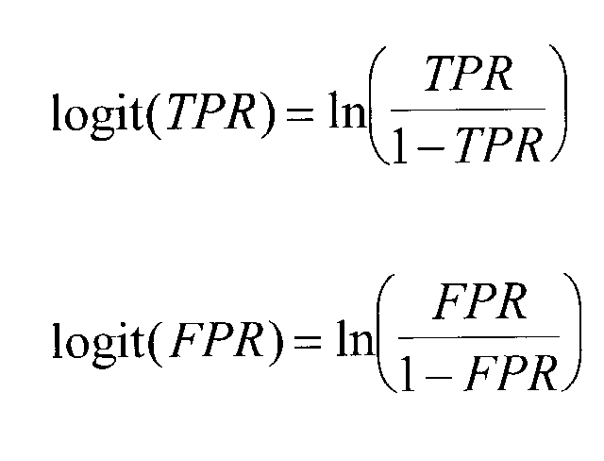
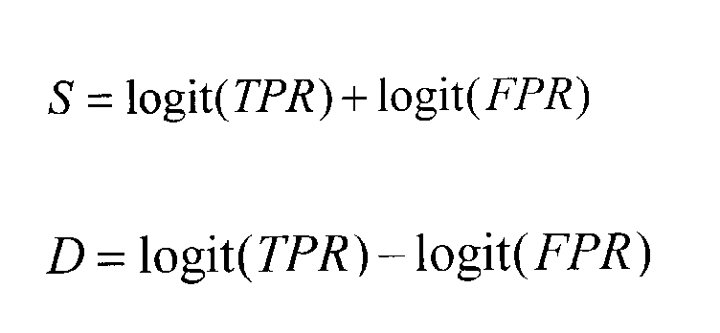
Moses-Littenberg statistical modelling of ROC curves
ROC curve transformation to linear plot
  Calculate the logits of TPR and FPR
  Plot their difference against their sum

Slide 21
Moses-Littenberg SROC method
Regression models used to fit straight lines to model relationship between test accuracy and test threshold
      D = a + bS
  Outcome variable D is the difference in the logits
  Explanatory variable S is the sum of the logits
  Ordinary or weighted regression – weighted by sample size or by inverse variance of the log of the DOR
What do the axes mean?
  Difference in logits is the log of the DOR
  Sum of the logits is a marker of diagnostic threshold

Slide 22
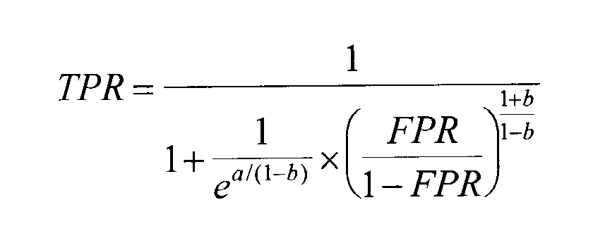
Producing summary ROC curves
Transform back to the ROC dimensions
where ‘a’ is the intercept, ‘b’ is the slope
  when the ROC curve is symmetrical, b=0 and the equation is simpler

Slide 23
Example: MRI for suspected deep vein thrombosis
Sampson et al. Eur Radiol (2007) 17: 175–181

Slide 24
SROC regression: MRI for suspected deep vein thrombosis
Transformation linearizes relationship between accuracy and threshold so that linear regression can be used

Slide 25
SROC regression: MRI for suspected deep vein thrombosis
The SROC curve is produced by using the estimates of a and b to compute the expected sensitivity (tpr) across a range of values for 1-specificity (fpr)

Slide 26
SROC regression: MRI for suspected deep vein thrombosis
The SROC curve is produced by using the estimates of a and b to compute the expected sensitivity (tpr) across a range of values for 1-specificity (fpr)

Slide 27
SROC regression: MRI for suspected deep vein thrombosis
The SROC curve is produced by using the estimates of a and b to compute the expected sensitivity (tpr) across a range of values for 1-specificity (fpr)

Slide 28
Problems with the Moses-Littenberg SROC method
Poor estimation
  Tends to underestimate test accuracy due to zero-cell corrections and bias in weights

Slide 29
Problems with the Moses-Littenberg SROC method: effect of zero-cell correction

Slide 30
Problems with the Moses-Littenberg SROC method: effect of zero-cell correction

Slide 31
Problems with the Moses-Littenberg SROC method
Poor estimation
  Tends to underestimate test accuracy due to zero-cell corrections and bias in weights
Validity of significance tests
  Sampling variability in individual studies not properly taken into account
  P-values and confidence intervals erroneous
Operating points
  knowing average sensitivity/specificity is important but cannot be obtained
  Sensitivity for a given specificity can be estimated

Slide 32
Mixed models
Hierarchical / multi-level
  allows for both within (sampling error) and
  between study variability (through inclusion of random effects)
Logistic
  correctly models sampling uncertainty in the true positive proportion and the false positive proportion
  no zero cell adjustments needed
Regression models
  used to investigate sources of heterogeneity

Slide 33
Investigating heterogeneity

Slide 34
CT for acute appendicitis
(12 studies)
Terasawa et al 2004

Slide 35
Sources of Variation
Why do results differ between studies?

Slide 36
Sources of Variation
Chance variation
Differences in (implicit) threshold
Bias
Clinical subgroups
Unexplained variation

Slide 37
Sources of variation: Chance
Chance variability:
total sample size=40
Chance variability:
total sample size=100

Slide 38
Investigating heterogeneity in test accuracy
May be investigated by:
  sensitivity analyses
  subgroup analyses or
  including covariates in the modelling

Slide 39
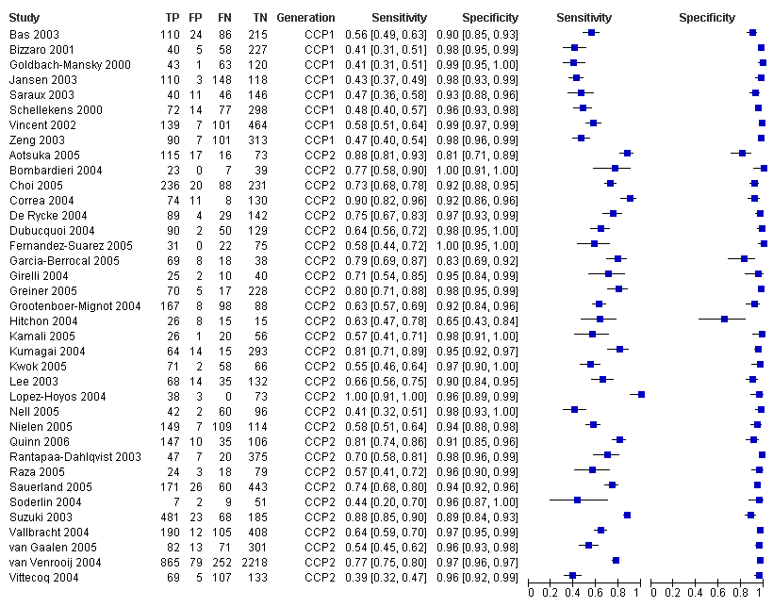
Example: Anti-CCP for rheumatoid arthritis by CCP generation (37 studies)
(Nishimura et al. 2007)

Slide 40
Anti-CCP for rheumatoid arthritis by CCP generation: SROC plot

Slide 41
Example: Triple test for Down syndrome
(24 studies, 89,047 women)
1
0.9
0.8
0.7
0.6
Sensitivity
0.5
0.4
0.3
0.2
0.1
0
1
0.9
0.8
0.7
0.6
0.5
0.4
0.3
0.2
0.1
0
Specificity
Notes:
41

Slide 42
Studies of the triple test
( = all ages; =aged 35 and over)
1
0.9
0.8
0.7
0.6
Sensitivity
0.5
0.4
0.3
0.2
0.1
0
1
0.9
0.8
0.7
0.6
0.5
0.4
0.3
0.2
0.1
0
Specificity
Notes:
42

Slide 43
Verification bias
Participants recruited
Participants analysed
 | Down's | Normal
Test +ve (high risk) | 50 | 250
Test -ve (low risk) | 50 | 4750
 | 100 | 5000
Down's | Normal
50 | 250
50 | 4750
100 | 5000
AMNIO
Sensitivity = 50%
Specificity = 95%
Follow-up = 100%
AMNIO
Participants recruited
Participants analysed
 | Down's | Normal
Test +ve (high risk) | 50 | 250
Test -ve (low risk) | 50 | 4750
 | 100 | 5000
Down's | Normal
50 | 250
34 | 4513
84 | 4763
Sensitivity = 60%
Specificity = 95%
Follow-up = 95%
AMNIO
BIRTH
237 lost (5%)
16 lost (33%)
Notes:
To understand that we have to look carefully as to how these studies have been executed, particuarlly how we have applied our referene standard.
There are two different approaches which have been used and we will briefly look at some hypothetical data to test this out
First, is some studies, all women were given an amniocentesis soon after the triple test. In these women, shown at the top here, what we note is that all women who were tested are included in the analysis – so the result should be correct as amnio is a very good test.
In other studies, amnio was reserved only for the women at very high risk – those who had a high risk triple test result. For the rest the reference diagnosis wasn’t made until after birth, based on testing of children displaying characteristics signs of downs. The key problem here is that some of the sample will be lost through miscarriage before this reference diagnosis – probably a higher proportion of Downs. Looking at the rsults, you can see that this poor methodology leads to overestimation of test results

Slide 44
Studies of the triple test
( = all ages; =aged 35 and over)
1
0.9
0.8
0.7
0.6
Sensitivity
0.5
0.4
0.3
0.2
0.1
0
1
0.9
0.8
0.7
0.6
0.5
0.4
0.3
0.2
0.1
0
Specificity
Notes:
44

Slide 45
Studies of the triple test
( = all ages; =aged 35 and over)
1
0.9
0.8
0.7
0.6
Sensitivity
0.5
0.4
0.3
0.2
0.1
0
1
0.9
0.8
0.7
0.6
0.5
0.4
0.3
0.2
0.1
0
Specificity
= all verified by amniocentesis
Notes:
45

Slide 46
Limitations of meta-regression
Validity of covariate information
  poor reporting on design features
Population characteristics
  information missing or crudely available
Lack of power
  small number of contrasting studies

Slide 47

Which test is best?
  The same approach used to investigate heterogeneity can be used to compare the accuracy of alternative tests

Slide 48
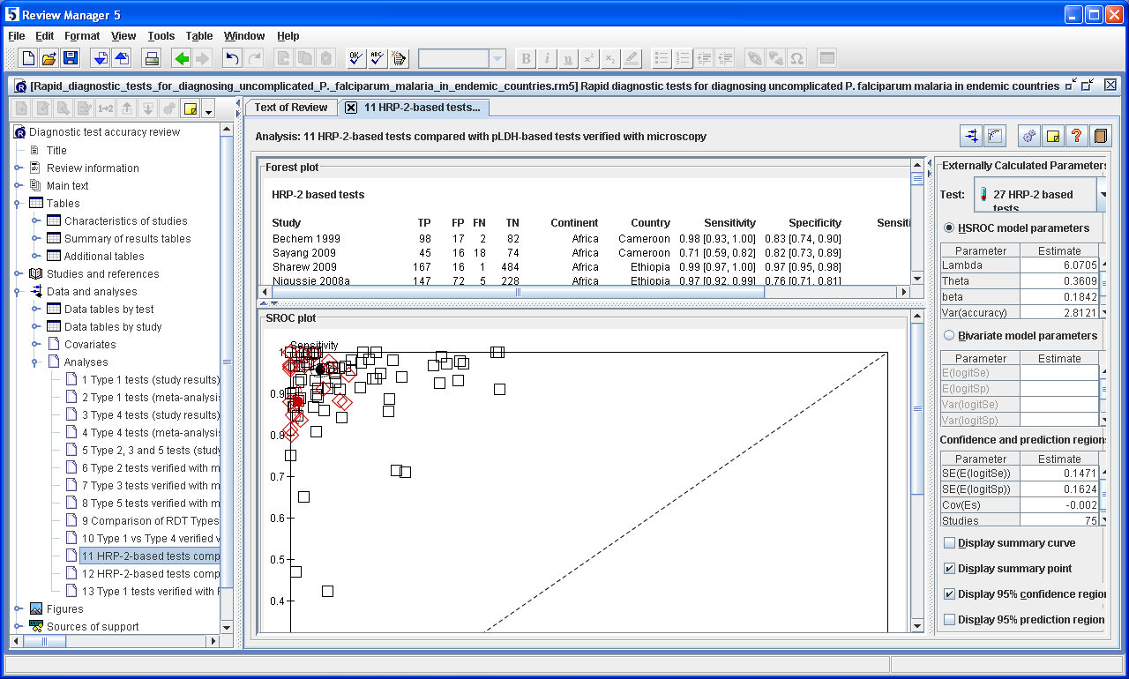

Slide 49
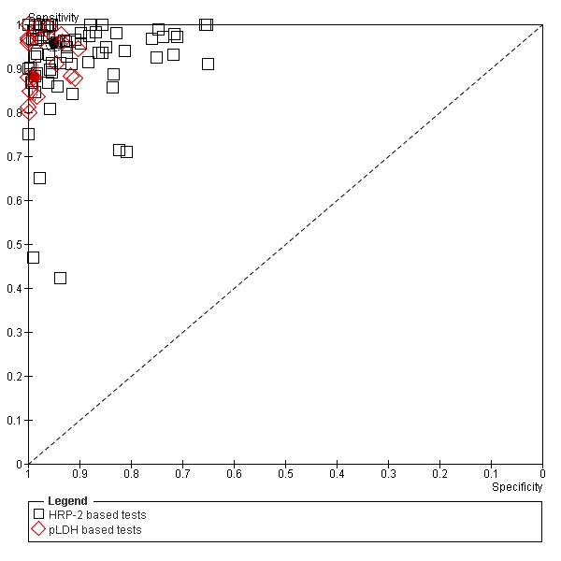
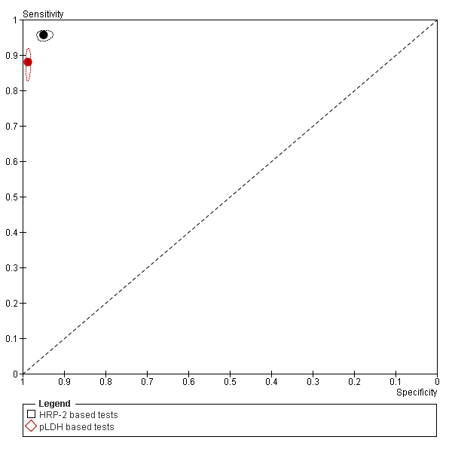
Comparison between HRP-2 and pLDH based RDT Types: all studies
75 HRP-2 studies and 19 pLDH studies

Slide 50
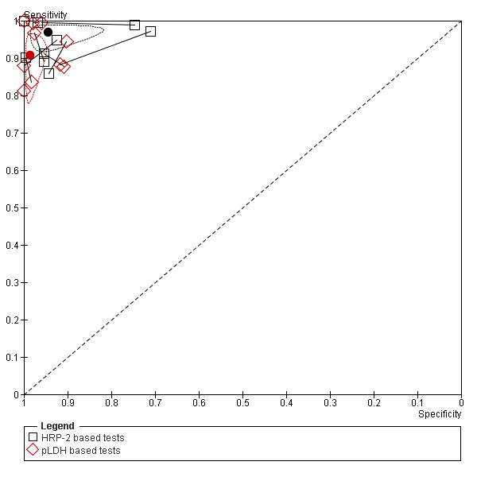
Comparison between HRP-2 and pLDH based RDT Types: paired data only
10 comparative studies

Slide 51
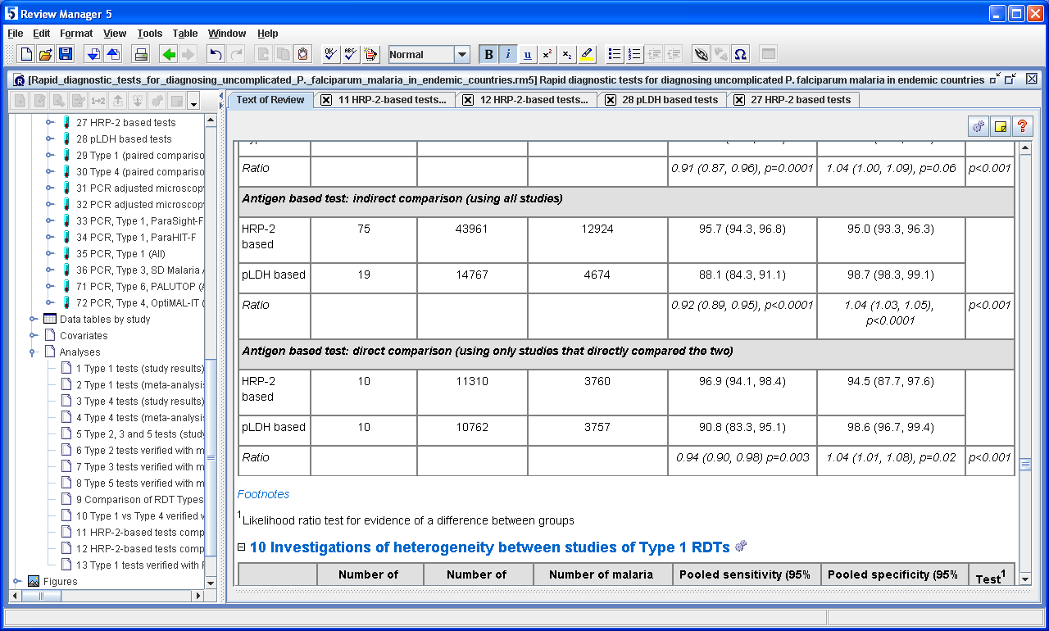

Slide 52
Issues in test comparisons
Some systematic reviews pool all available studies that have assessed the performance of one or more of the tests.
  Can lead to bias due to confounding arising from heterogeneity among studies in terms of design, study quality, setting, etc
Adjusting for potential confounders is often not feasible
Restricting analysis to studies that evaluated both tests in the same patients, or randomized patients to receive each test, removes the need to adjust for confounders.
Covariates can be examined to assess whether the relative performance of the tests varies systematically (effect modification)
For truly paired studies, the cross classification of tests results within disease groups is generally not reported

Slide 53


Slide 54
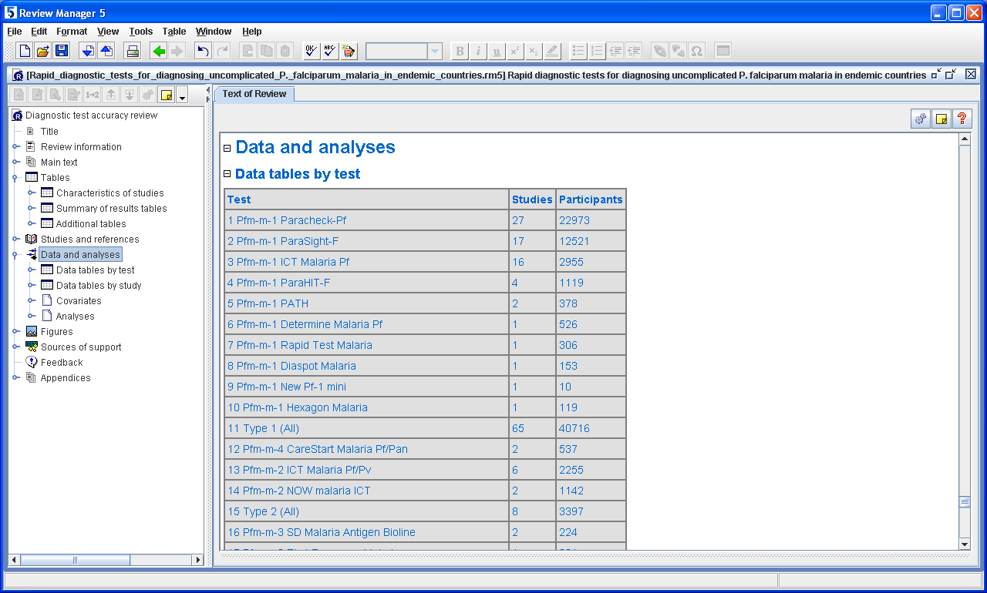

Slide 55
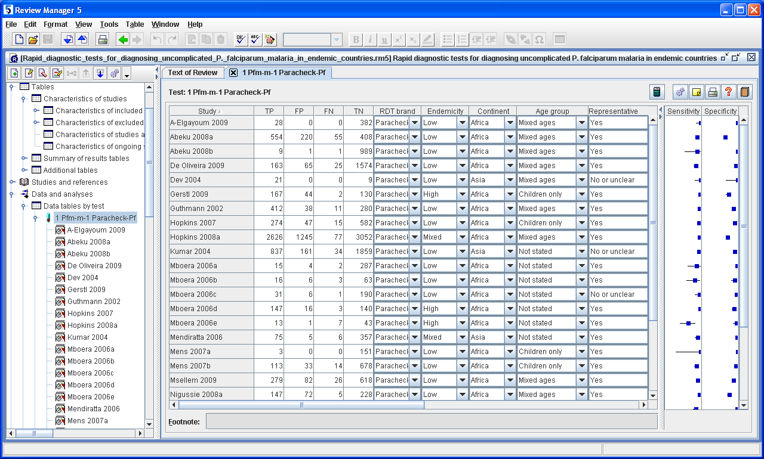

Slide 56
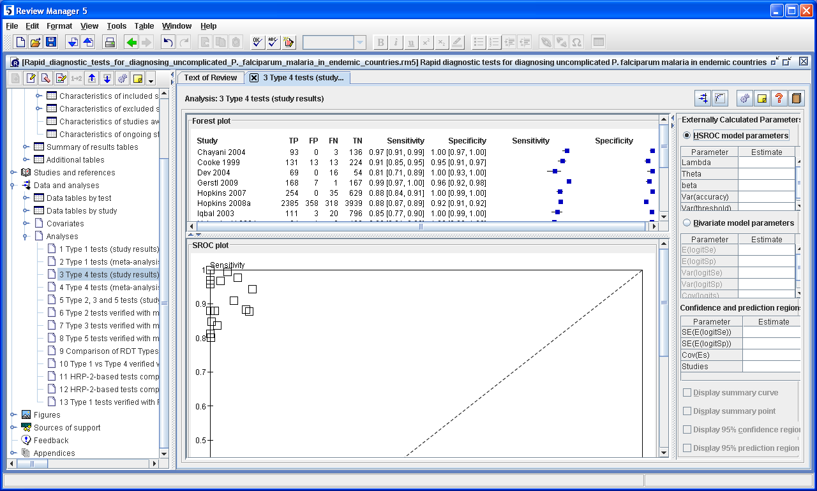

Slide 57
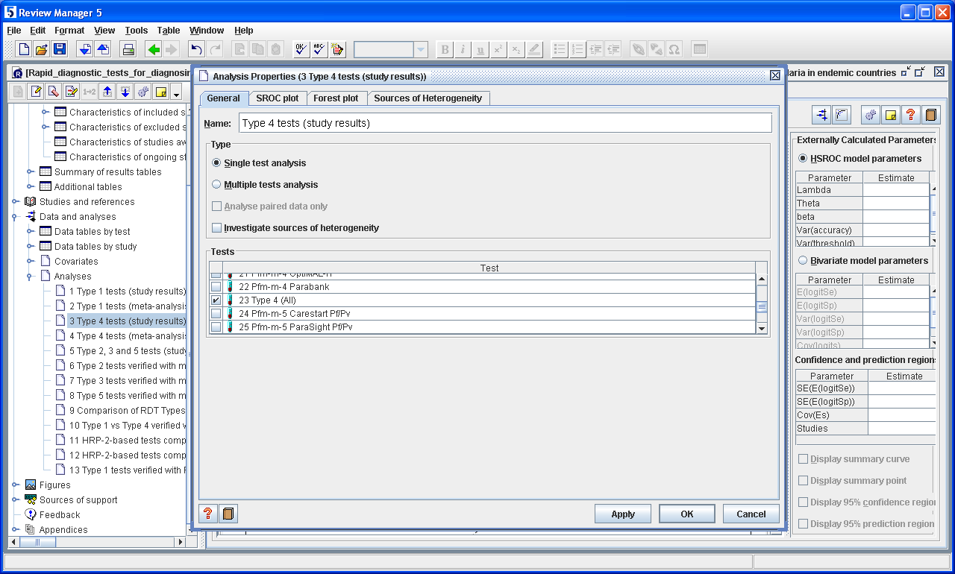

Slide 58
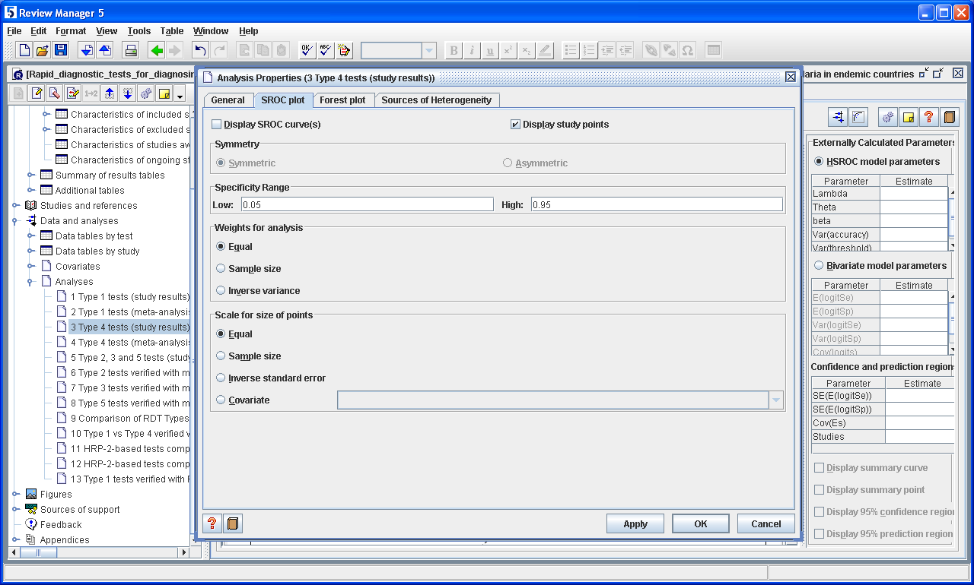

Slide 59
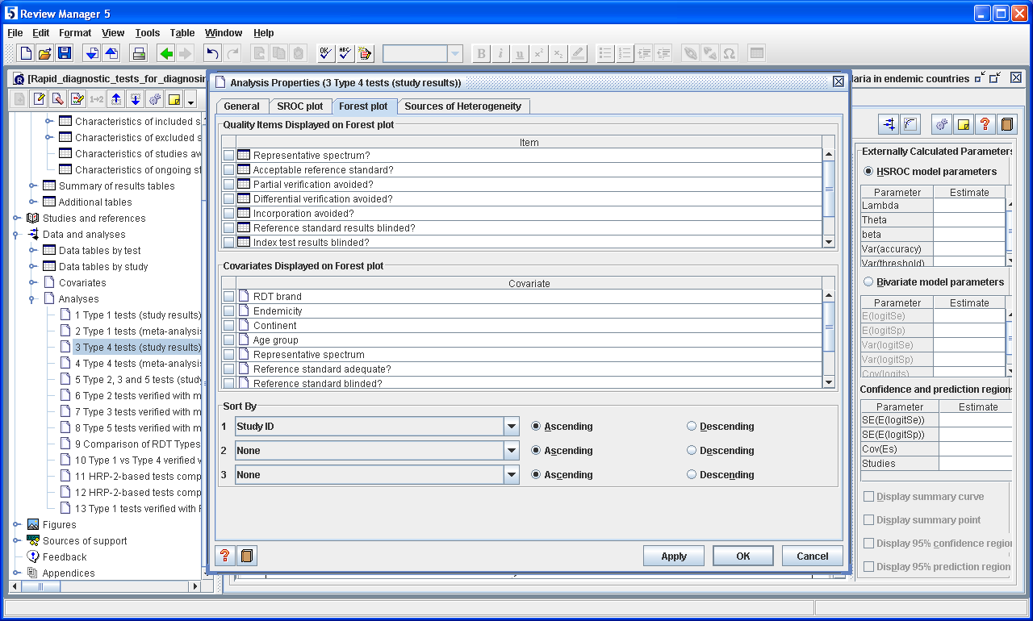

Slide 60
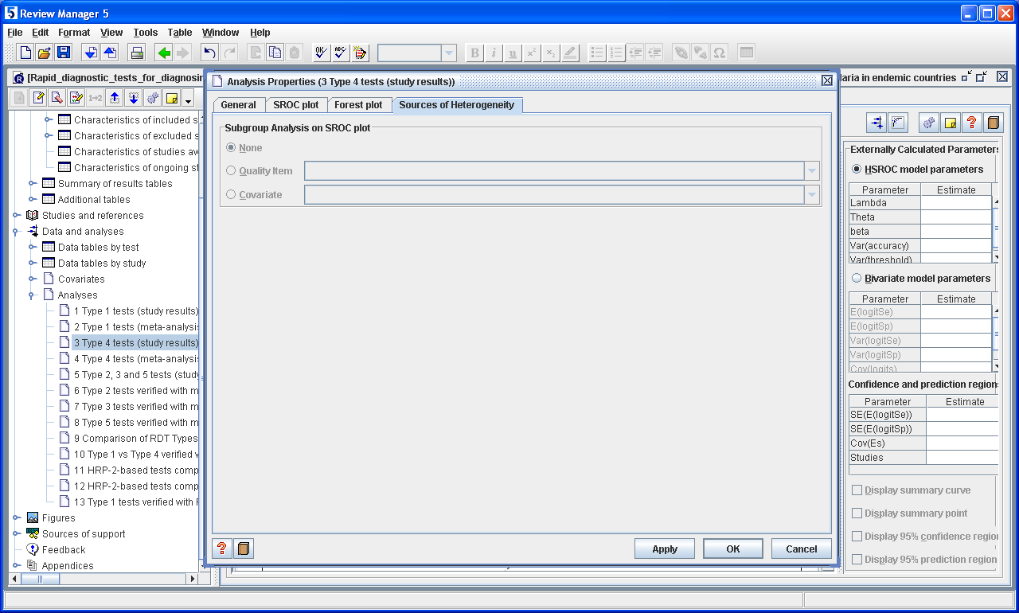

Slide 61
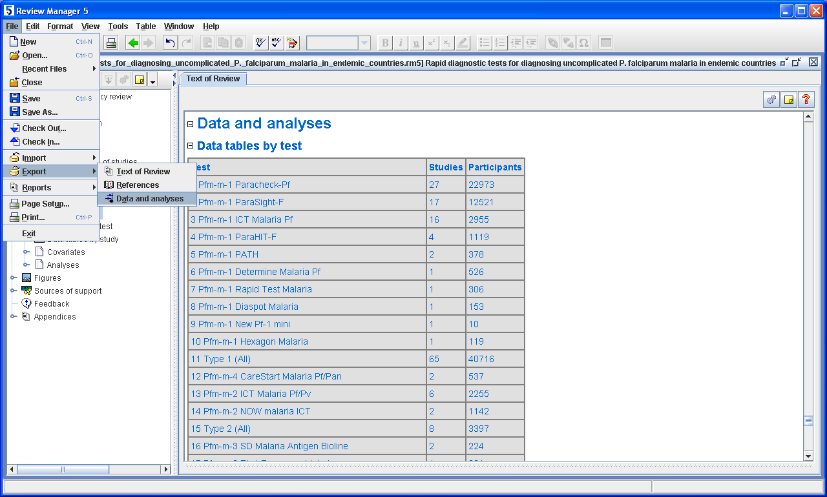

Slide 62
Summary
Different approach due to bivariate correlated data
Moses & Littenberg method is a simple technique
  useful for exploratory analysis
  included directly in RevMan
  should not be used for inference
Mixed models are recommended
  Bivariate random effects model
  Hierarchical summary ROC (HSROC) model

Slide 63
RevMan DTA tutorial included in version 5.1
Handbook chapters and other resources available at:
http://srdta.cochrane.org

