Slide 1




Postoperative pain
Introduction to acute postoperative pain

Slide 2
Contents
01 | Background
02 | Definitions of acute and chronic pain
03 | Prevalence of acute pain and postoperative pain
04 | Importance of acute postoperative pain
05 | A look at patient perspectives
06 | Acute vs chronic pain after surgery

Slide 3
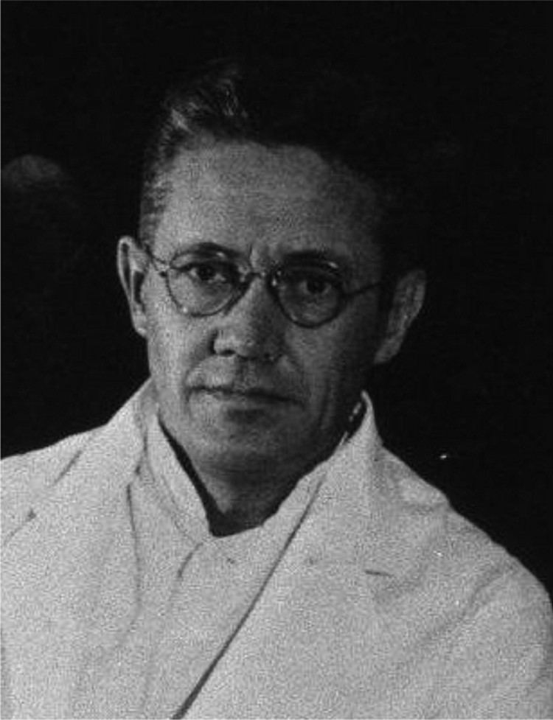
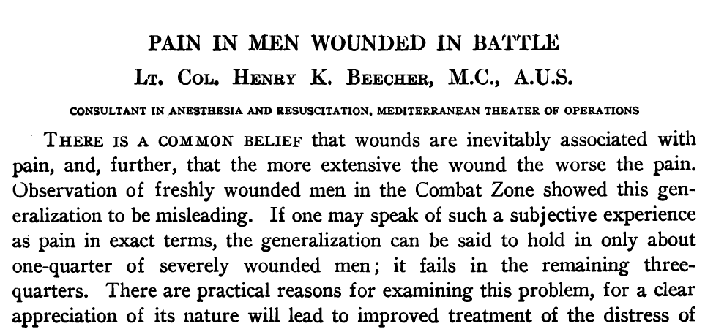
The long history of pain research
Ann Surg. 1946 Jan; 123(1): 96–105

Slide 4
Sharing and understanding
Pain is an experience common to all mankind, with the exception of a very few individuals with congenital insensitivity
Pain is usually described as being acute (lasting less than 3 months) or chronic (lasting longer than 3 months)
Pain, including acute pain, is frequently reported in many different medical conditions
Important lessons about evidence and bias in pain trials have been learned for over 70 years
This series aims to help reviewers who are not specialists in pain – both to share those lessons and understand their importance in evaluating evidence for postoperative pain

Slide 5
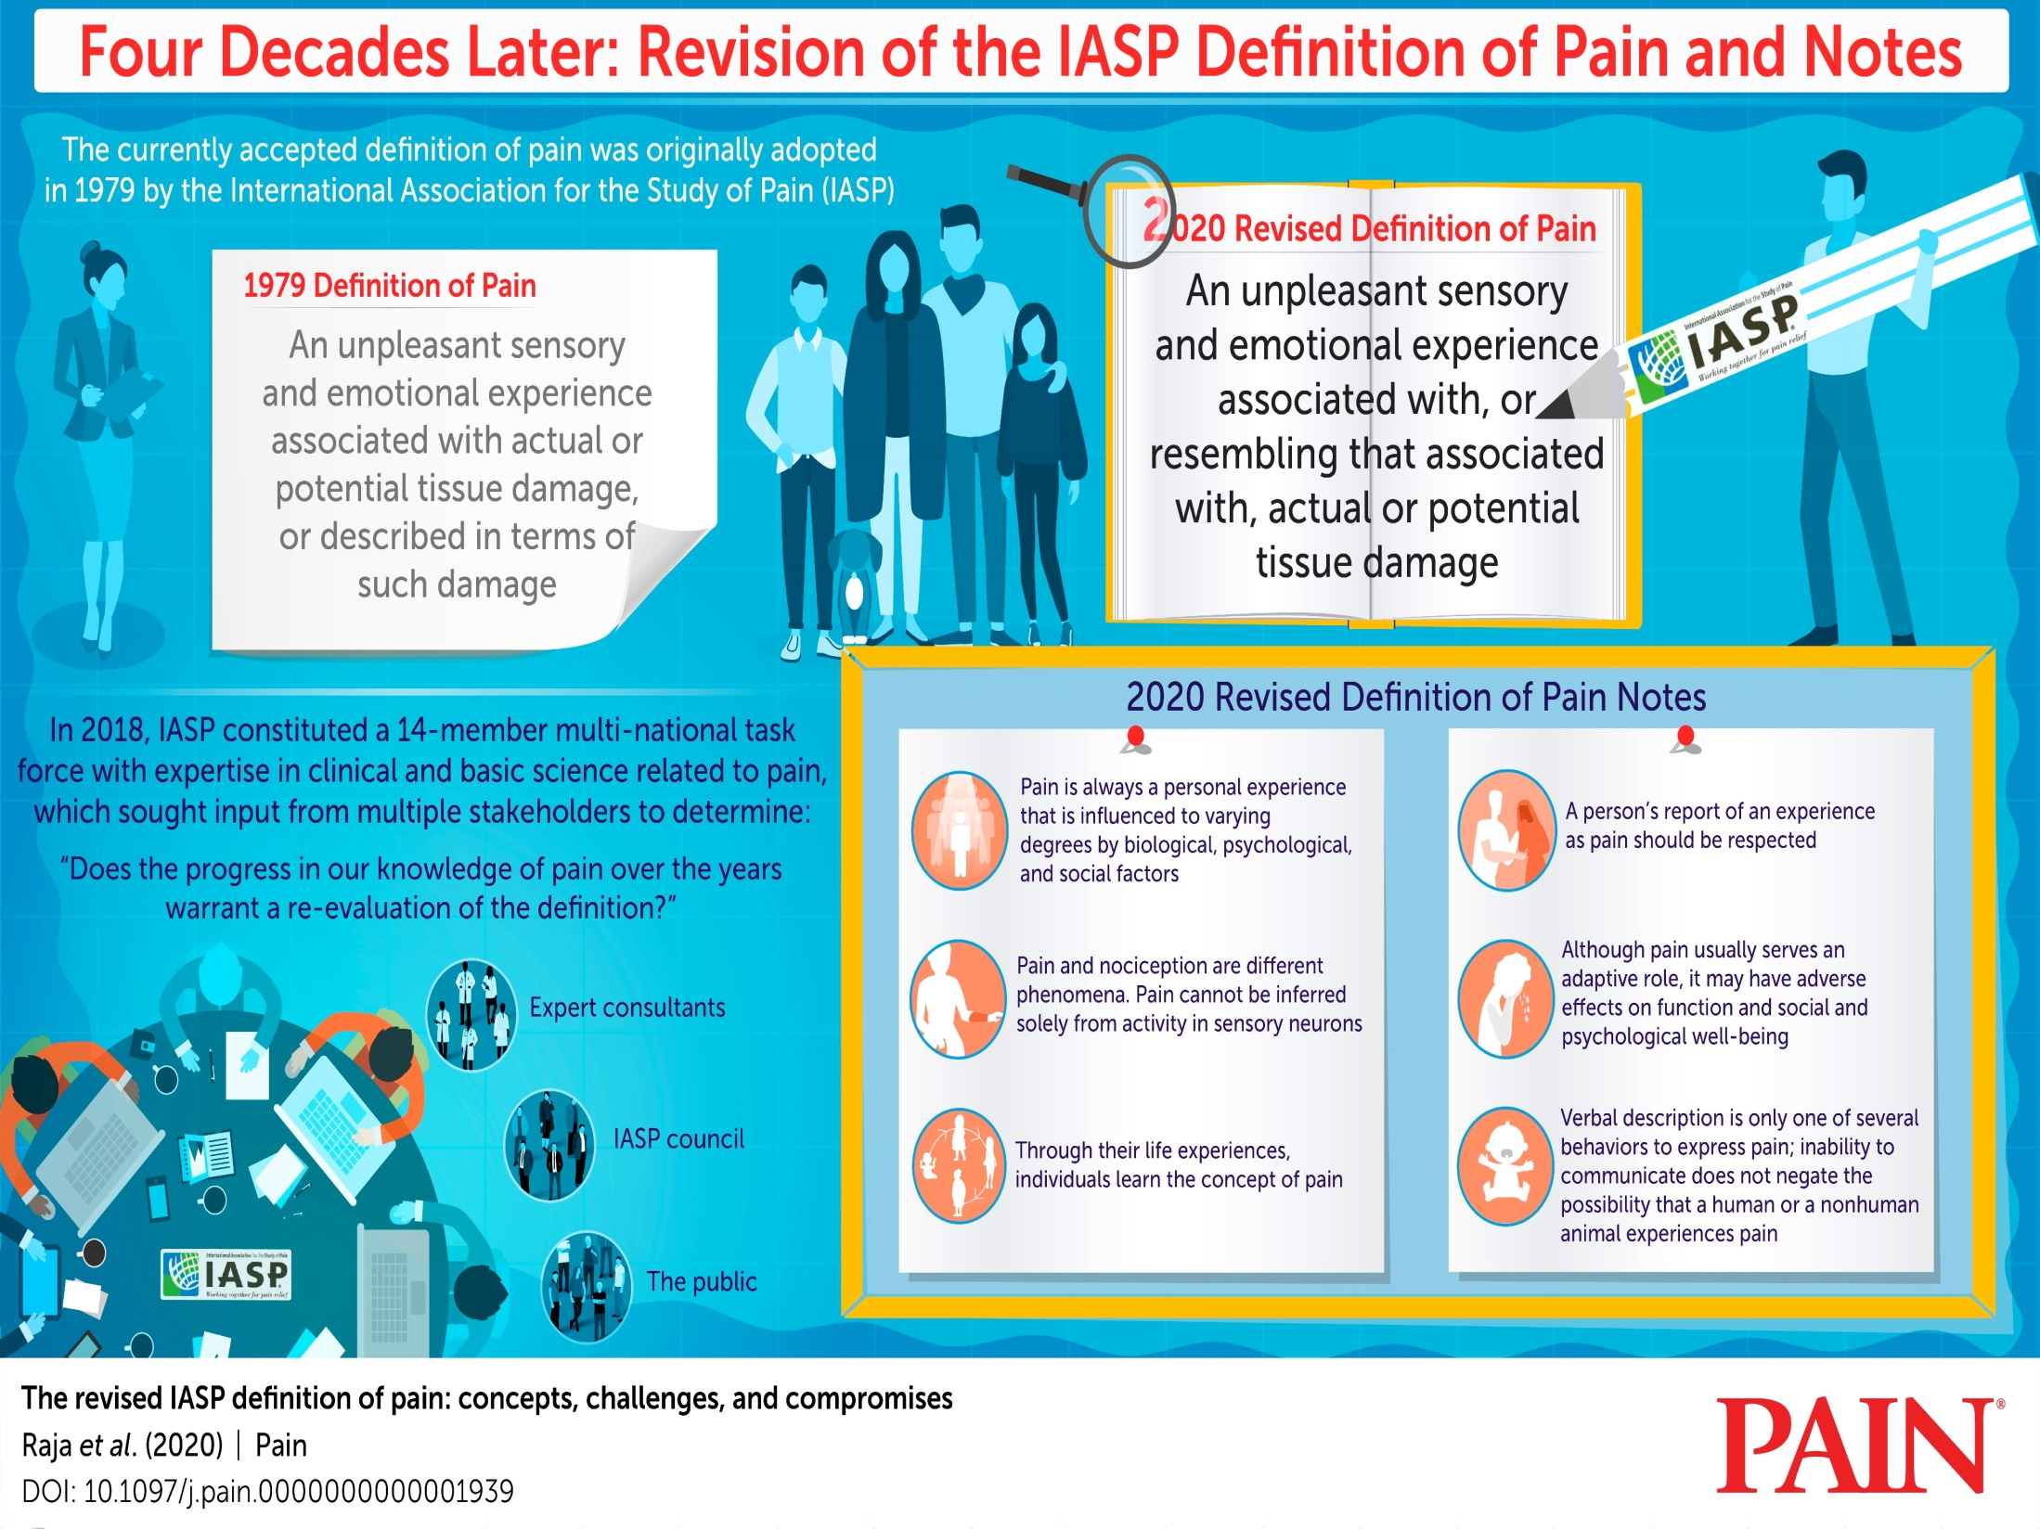

Slide 6
Definition of pain (IASP 2020)
Pain: An unpleasant sensory and emotional experience associated with, or resembling that associated with, actual or potential tissue damage.
Acute pain is awareness of noxious signalling from recently damaged tissue, complicated by sensitization in the periphery and within the central nervous system. Its intensity changes with inflammatory processes, tissue healing, and movement. The rate at which acute pain resolves is one of its key features.
Raja et al. Pain 2020 161:1976-82

Slide 7
Definition of pain (IASP 2020)
Pain is always a personal experience that is influenced to varying degrees by biological, psychological, and social factors.
Pain and nociception are different phenomena. Pain cannot be inferred solely from activity in sensory neurons.
Through their life experiences, individuals learn the concept of pain.
A person’s report of an experience as pain should be respected.
Although pain usually serves an adaptive role, it may have adverse effects on function and social and psychological well-being.
Verbal description is only one of several behaviours to express pain; inability to communicate does not negate the possibility that a human or a nonhuman animal experiences pain.
Raja et al. Pain 2020 161:1976-82

Slide 8
Examples of acute pain
Postoperative pain
Labour and childbirth
Menstrual cramps
Acute headaches
Toothaches
Trauma, burns, or other injuries and conditions requiring hospital visits
Sports injuries
Overuse injuries and strains
Oral mucositis in cancer patients who undergo head and neck irradiation
Chemotherapy-induced peripheral neuropathy in cancer patients
Diagnostic procedures such as biopsies

Slide 9
Global prevalence and pain 2010
Six of top 11 conditions are pain-related, including headache and toothache
Condition | Percentage with problem
Dental caries of permanent teeth | 35
Tension-type headache | 21
Migraine | 15
Fungal skin diseases | 14
Other skin diseases | 12
Chronic periodontitis | 11
Mild hearing loss | 11
Acne | 9.4
Low back pain | 9.2
Dental caries of milk teeth | 9.0
Iron deficiency anaemia | 8.8
Vos et al. Lancet 2012 380: 2163-96

Slide 10
Acute pain study lessons
Some people after operation do not have pain
Some people after operation have pain
In some with pain, the pain is at least moderate at some time
In some who have at least moderate pain, the pain may not last long, even without treatment
But, depending on the patient and intervention, pain can be moderate or severe and last for days or even longer; severe postoperative pain is a risk factor for persistent pain

Slide 11
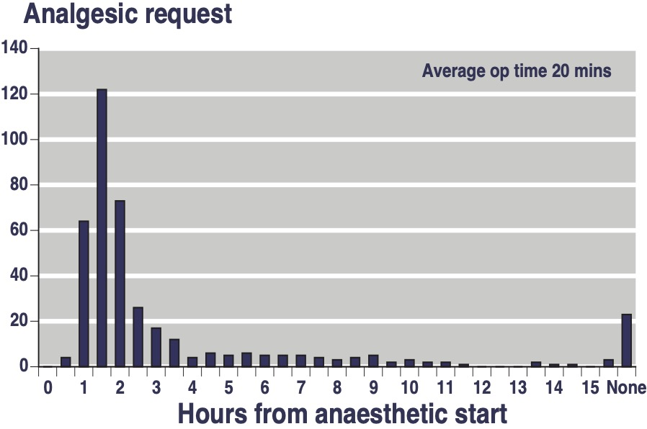
Need for analgesic after surgery
6% need no analgesic after minor surgery
Postoperative analgesic requirements of 410 patients in RCTs undergoing elective orthopaedic limb surgery with non-analgesic premedication
McQuay et al, JRSM 1982 75: 705-8

Slide 12
Postoperative pain statistics
Data from a UK hospital 25 years ago
Large data set
Bruster et al. BMJ 1994 309: 1542-6

Slide 13
Postoperative pain statistics
Postoperative pain is the primary concern of most patients before surgery²
4 out of 5 patients report reported moderate to severe pain at some time after surgery ^{2,3}
High postoperative pain is correlated with longer hospital stay ³
Many studies have documented that pain in hospital is both common and poorly treated. Only a small sample is presented here
Apfelbaum et al: Anesth Analg 2003;97:534-540
Shang et al: Drugs. 2003;63:855-867
Sharma et al: Indian J Anaesth 2020;64:403-408

Slide 14
Readmissions from day surgery: Pain is the most common reason
Other
17%
Surgical
38% of those reporting pain underwent orthopaedic surgeries
ADE = adverse drug event;
N/V = nausea/ vomiting
ADE
21%
3%
Medical
14%
Pain
Bleeding
38%
N/V
3%
4%
Coley et al. J Clin Anesth 2002;14:349-353

Slide 15
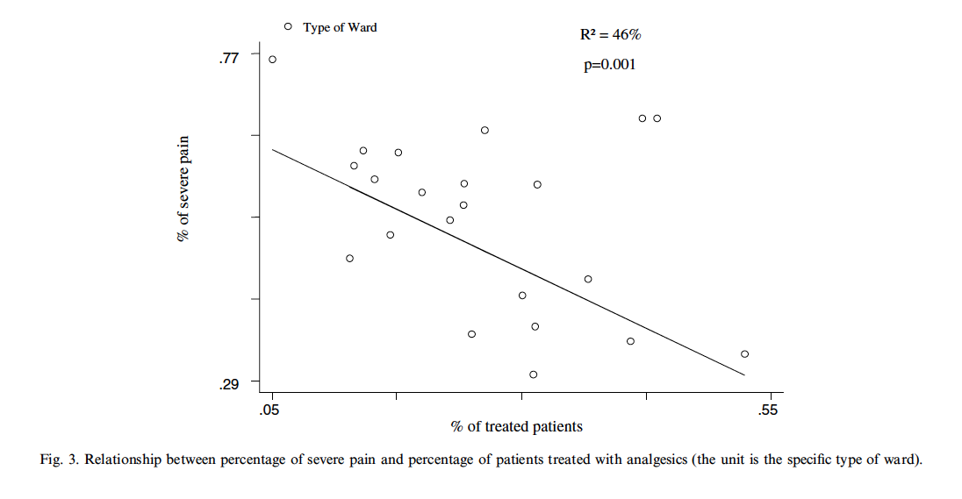
Pain in hospital
Italian nationwide study of pain in hospital wards
Strong correlation between incidence of severe pain and less use of analgesics
Visentin M et al. Eur J Pain 2005;9:61-7

Slide 16
Postoperative pain taken seriously
Survey of 922 pain scores over one month in a military postoperative ward
Measures taken to minimise postoperative pain
Good postoperative pain outcomes are achievable
Aldington et al. Phil Trans B 2011;366:268-75

Slide 17
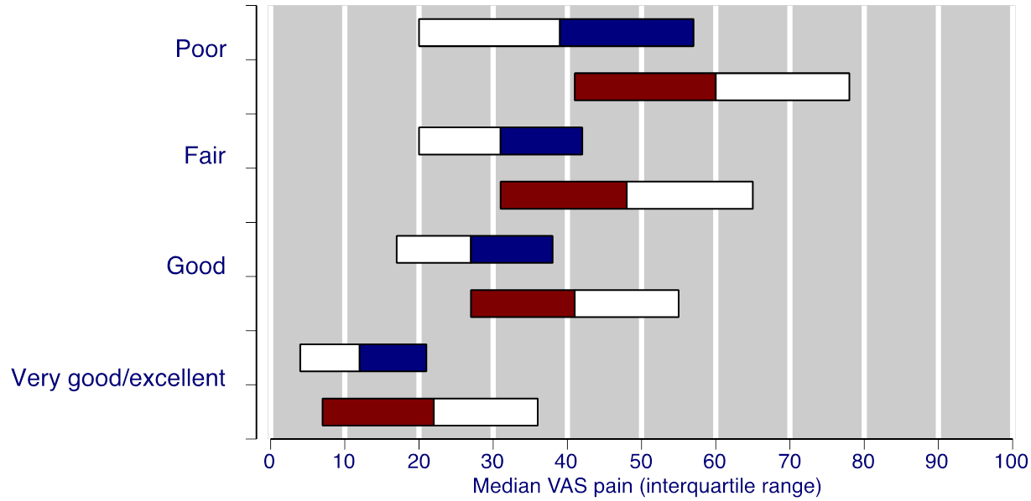
People don’t like pain
Low pain means pain ideally below 30/100 mm VAS over 48 hours
Participant subjective rating of pain medication compared with mean 48-hour pain scores for postoperative pain (N = 913)
Bars show 95% CI, with colour change indicating reported value; blue at rest, red on movement
Mhuircheartaigh et al. BJA 2009 103:871-84

Slide 18
People don’t like pain
Low pain means low analgesic requirement means a good experience
Participant subjective rating of pain medication compared with patient-controlled fentanyl consumption for postoperative pain (N = 913)
Bars show 95% CI, with colour change indicating reported value
Mhuircheartaigh et al. BJA 2009 103:871-84

Slide 19
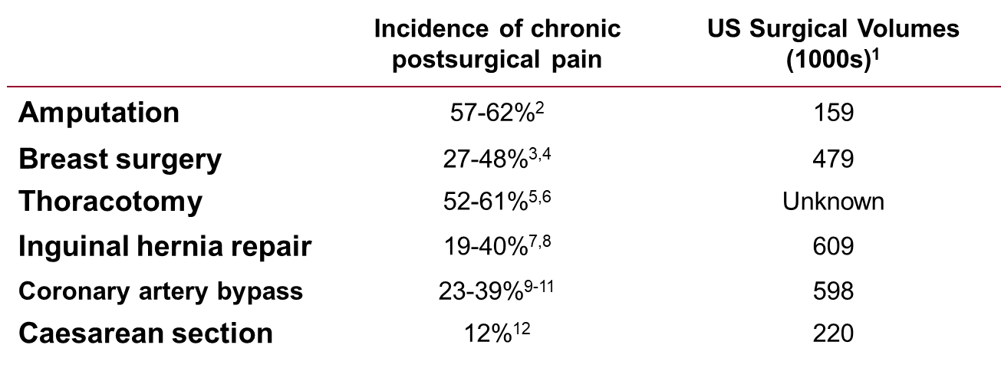
Acute pain after surgery is different from chronic pain lasting over 3 months Incidence of chronic pain following common procedures
1. Kehlet et al. Lancet. 2006;367:1618-1625; 2. Hanley et al. J Pain. 2007;8:102-10; 3. Carpenter et al. Cancer Prac. 1999;7:66-70; 4. Poleschuk et al. J Pain. 2006;7:626-634; 5. Katz et al. Clin J Pain. 1996;12:50-55; 6. Perttunen et al. Acta Anaesthesiol Scand. 1999;43:563-567; 7.Massaron et al. Hernia. 2007;11:517-525; 8. O’Dwyer et al. Br J Surg. 2005;92:166-170; 9. Steegers et al. J Pain. 2007;8:667-673; 10. Taillefer et al. J Thorac Cardiovasc Surg. 2006;131:1274-1280; 11. Bruce et al. Pain. 2003;104:265-273; 12. Nikolajsen et al. Acta Anaesthesiol Scand. 2004;48:111-116.

Slide 20
Acute and chronic pain
Acute and chronic pain
Brief duration
Typically follows tissue injury (surgical procedure)
Generally resolves with healing
Acute pain is a symptom
Chronic pain
Persists beyond the usual course of an acute condition and beyond expected time of healing
May develop as a consequence of untreated acute pain
Chronic pain is a disease

Slide 21
Acknowledgements
Thank you to the Cochrane Network Innovation Fund
Thank you to Mohammed A. Abusayed (University Hospitals of Derby and Burton, UK) for auditing reviews of interventions for pain in the Cochrane Library in 2016
Thank you to all the project team members and MOSS key contacts
Joanne Abbott; Geert Crombez; Rob Dellavalle; Christopher Eccleston; Anna Erskine; Emma Fisher; Kerry Harding; Jennifer Hilgart; John Lawrenson; Hopin Lee; Nuala Livingstone; Lara Maxwell; Andrew Moore; Gill Norman; Neil O'Connell; Roses Parker; Phil Riley; Kate Seers; Teo Aminah Wasteneys Quay; Andrew Smith; Martin Tramèr; Peter Tugwell; Katie Webster; Amanda C de C Williams
All the slides and documents hosted on the PaPaS website https://papas.cochrane.org/resources/acute-pain-outcomes

