Slide 1




Postoperative pain
Considerations of study size

Slide 2
Contents
01 | Background to study size
02 | Examples of treatment group sizes in acute pain
03 | Examination random variations with small group size
04 | What is small, and problems with small studies
05 | Examples of problems with small study size
06 | Conclusions

Slide 3
Background to small study size
Traditionally, many clinical trials have been relatively small, with only a few tens of participants in each treatment arm
More recent studies have tended to be larger, with sometimes more than 100 of participants in each treatment arm
There is a considerable literature on the problems with small studies, especially when only a small number of small studies are available
The main issue is one of random play of chance
A subsidiary issue is one of possible bias

Slide 4
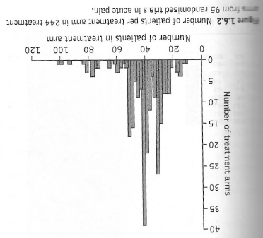
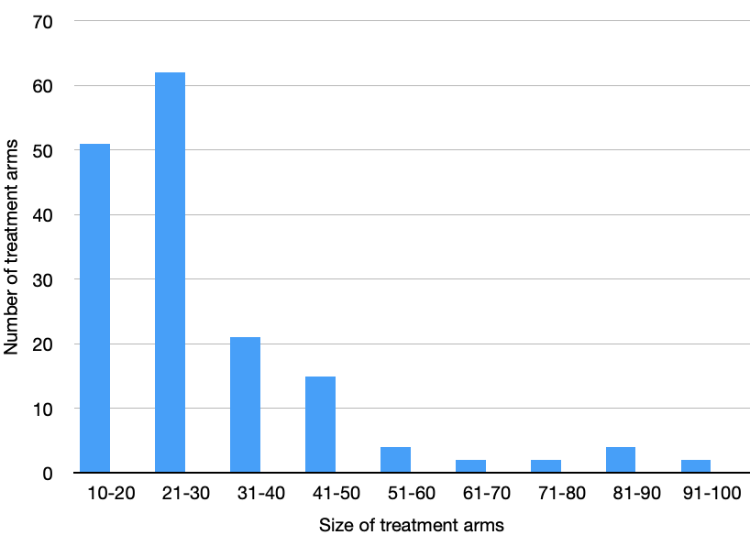
Study size in acute pain
Standard oral analgesic trials
Typical perioperative trials

Slide 5
Randomness in practice
Plot showing data from Cochrane review of ibuprofen 400 mg versus placebo in acute postoperative pain – bubble size is proportional to study size
Standard experimental
procedures and six-hour duration
Outcome > 50% pain relief
Why the great variability between individual trials?
Moore et al. Pain 1998 78:209-16

Slide 6
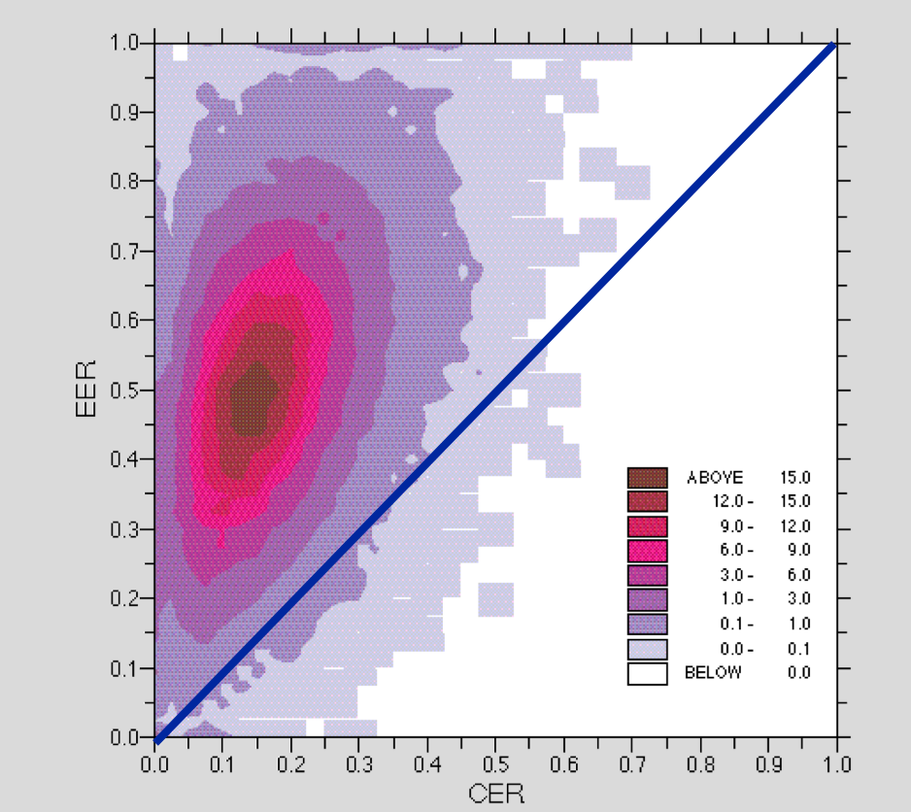
Randomness by computer
Computer modelling of 10,000 simulated RCTs based on average of ibuprofen 400 mg results from meta-analysis, and similar size variation
Higher density shows greater probability of result, but wide possible range for any single trial
Random play of chance and small study size explain wide disparity between individual results
EER – experimental event rate
CER – control event rate
Moore et al. Pain 1998 78:209-16

Slide 7
Randomness in placebo (RCTs)
All clinical trials in Cochrane Reviews
All third molar extraction
All randomized
All double-blind
All with initial moderate or severe pain
All oral placebo
Standard measurement
Standard timing
Standard outcome
Only individual trials
Huge variability with small study size
Moore et al, Pain 2018 159: 2234-44

Slide 8
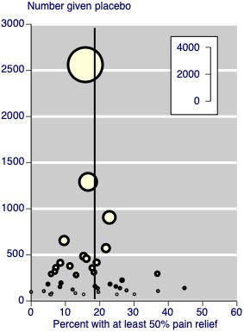
Randomness in placebo (SR)
56 acute pain meta-analyses (Cochrane)
Consistent methods, patients, outcome, measurements, duration etc
Outcome > 50% pain relief
Plot of response with placebo versus sample size in meta-analysis
Small numbers have greater variability, between 0% and 45%
Moore & McQuay. 2006. Bandolier’s Little Book of Making Sense of the Medical Evidence

Slide 9
What is small
Very small studies have fewer than 50 participants in a treatment arm
Intermediate size studies have 51 to 200 participants in a treatment arm
Large studies have more than 200 participants in a treatment arm
It is worth noting that some researchers would argue that these numbers should be (at least) doubled to avoid potential bias, or only the largest trials should be analysed
Size is a sensitive topic that may be situation dependent, but small studies have consistently been shown to mislead

Slide 10
The trouble with small studies
The random play of chance in individual small studies means that single small studies cannot provide good quality evidence
Even a number of small studies (typically fewer than 10 is regarded as a small number in some places in the Cochrane Handbook) cannot when combined produce secure evidence
There are examples, mainly from chronic pain and elsewhere, that small studies produce overly-large treatment effects when compared with large randomized studies, probably due to quality or bias issues

Slide 11
Thalidomide & advanced small-cell lung cancer
Two small single-arm phase II trials and a small randomised placebo-controlled trial reported consistent evidence that thalidomide could increase overall survival
The 1-year survival rate in these three studies were 46 (n = 25), 52 (n = 30) and 49% (n = 49); all higher than the expected value of 20 – 30%
Median survival was 11.7 (n = 49) and 8.7 (n = 43) months in the thalidomide and placebo arms, respectively - substantial difference
A large double-blind placebo-controlled phase III trial (n = 724) of thalidomide versus placebo showed no evidence of an effect
  The 1-year survival rates were 37 and 41% in the thalidomide and placebo arms
  The median survival was 10.1 and 10.5 months in the thalidomide and placebo arms
Hacksaw. Eur Respir J 2008; 32: 1141–1143

Slide 12
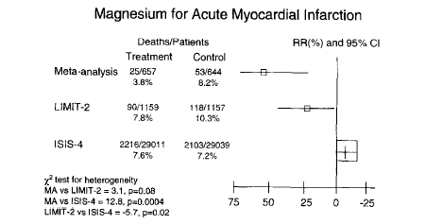
Number of events is important
Small meta-analyses (ie those with fewer than 200 outcome events) may only be useful for summarizing the available information and generating hypotheses for future research
Flather et al. Control Clin Trials 1997 18: 568-579

Slide 13
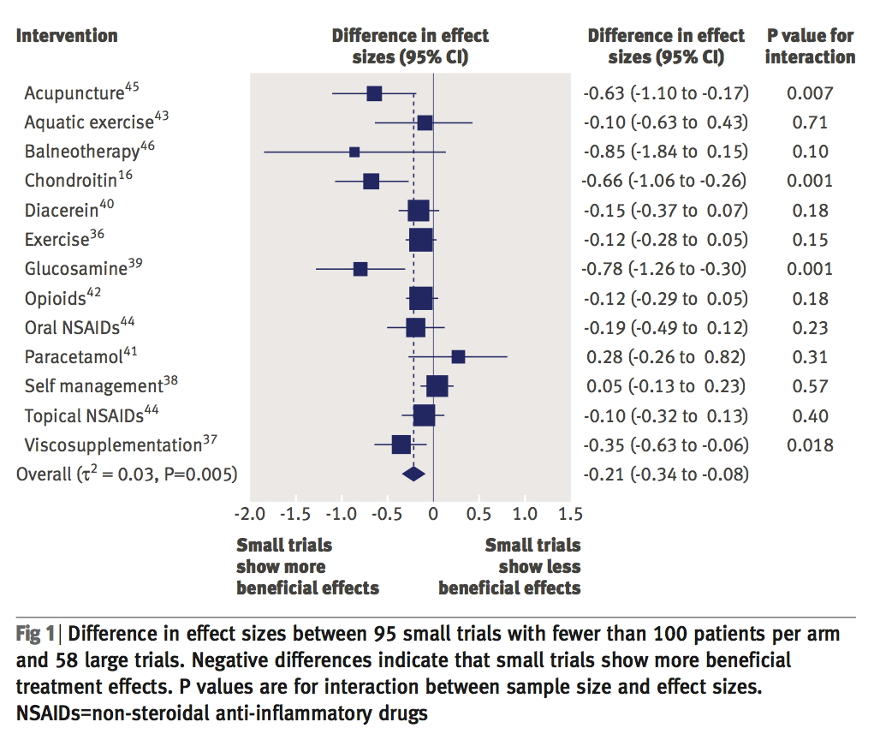
Small studies overestimate treatment effect
Comparison of large and small trials for interventions in osteoarthritis
Small is fewer than 100 per treatment arm
Small trials had significantly bigger effects
Nüesch et al. BMJ 2010 341;c3515

Slide 14
Accurate estimation of treatment effect - here as number needed to treat (NNT) ± 0.5
Likelihood of an accurate estimate of treatment effect in acute pain studies using computer simulations
Based on rage of effect sizes seen for single dose analgesics in postoperative pain
Small effect size (high NNT) and small size make accurate assessment of the magnitude of the effect unlikely
Large effect size (low NNT) and large size make accurate assessment of the magnitude of the effect probable
Moore et al, Pain 1998 78: 209-16

Slide 15
Efficacy changing when adding data
Incremental numbers of patients
NNT ± 0.5
1975
2001
Publication year
Moore et al, 2013. Bandolier's Little Book of Pain

Slide 16
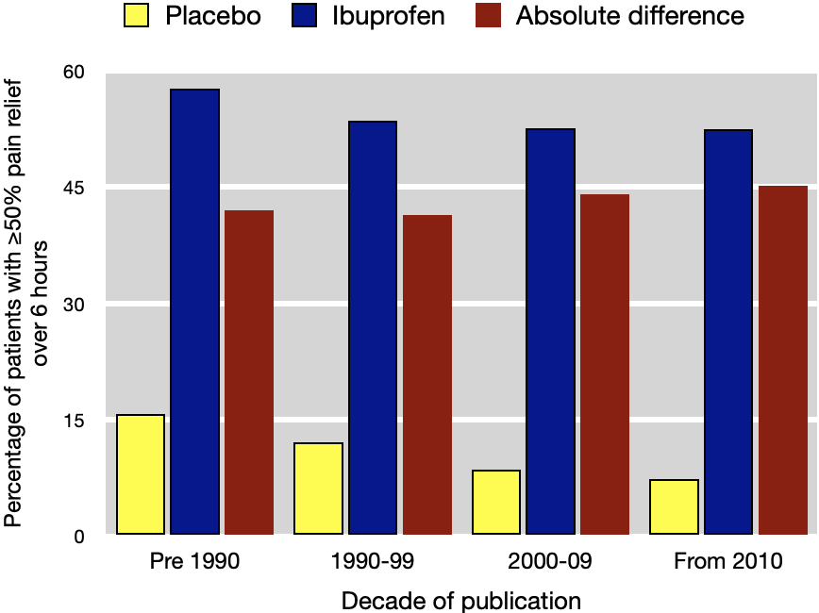
Large amounts of good data produce consistent results
Largest acute pain dataset is with ibuprofen acid 400 mg
Data over 5 decades in standardised single dose postoperative pain studies
Analysis by decade shows great consistency
Moore et al, Pain 2018 159: 2234-44

Slide 17
Think about size
When doing your analyses think about trial size, and about the total amount of information available
It is about the number of events as well as the number of participants
Worth performing a sensitivity analysis according to size – major size effects do occur in acute pain situations, but less commonly than chronic pain
Take size into account when making a GRADE estimation
Be cautious about the magnitude of any effect with a small number of small trials

Slide 18
Acknowledgements
Thank you to the Cochrane Network Innovation Fund
Thank you to Mohammed A. Abusayed (University Hospitals of Derby and Burton, UK) for auditing reviews of interventions for pain in the Cochrane Library in 2016
Thank you to all the project team members and MOSS key contacts
Joanne Abbott; Geert Crombez; Rob Dellavalle; Christopher Eccleston; Anna Erskine; Emma Fisher; Kerry Harding; Jennifer Hilgart; John Lawrenson; Hopin Lee; Nuala Livingstone; Lara Maxwell; Andrew Moore; Gill Norman; Neil O'Connell; Roses Parker; Phil Riley; Kate Seers; Teo Aminah Wasteneys Quay; Andrew Smith; Martin Tramèr; Peter Tugwell; Katie Webster; Amanda C de C Williams
All the slides and documents hosted on the PaPaS website https://papas.cochrane.org/resources/acute-pain-outcomes

