Slide 1
Postoperative pain
Applying lessons in practice

Slide 2
Contents
01 | Looking at data in practice, and methods
02 | Pain at rest – effect of size
03 | Pain at rest – effect of pain level with control
04 | Opioid consumption – effect of size
05 | Opioid consumption – effect of consumption with control
06 | Conclusions

Slide 3
Looking at data in practice
Example review is “Perioperative intravenous ketamine for acute postoperative pain in adults”, CD012033
Published December 2018 – few additional studies in the intervening period
Complex review requiring considerable protocol development
Included 130 studies with 8341 participants, not all of whom provided data for all analyses
Largest data sets were for pain and opioid consumption over the first 24 postoperative hours

Slide 4
Methods
The review had prespecified sensitivity analysis criteria of:
study size (larger than median, and over 50/group)
pain intensity in placebo control (> 40/100 mm visual analogue scale (VAS))
type of surgery
Here we repeat some of these analyses but using graphical approaches to be able to view the data itself rather than the results of statistical analyses
This can provide a different way of understanding some of the issues in previous slide sets (see https://papas.cochrane.org/resources/acute-pain-outcomes)

Slide 5
Methods
The following slides show graphics and analyses performed using the data from the original review
Done using Excel for calculations and Numbers for graphics
Any pooled data were calculated using weighting by study size, which is not available in RevMan, but is more convenient for exploratory analyses
Looks at pain at rest at 24 hours and cumulative opioid consumption by 24 hours as these provided the largest data sets in the review
Examined first by size, and then by pain or opioid consumption in placebo controls

Slide 6
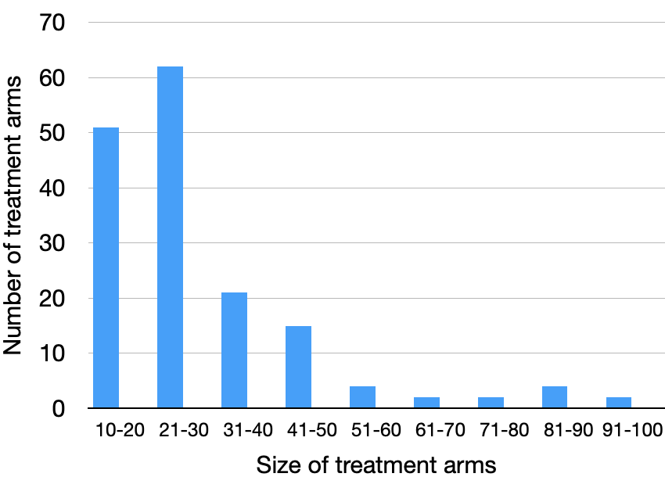
Pain at rest - 24 hours postoperatively
This analysis depended on 82 RCTs with 5000 participants
Most ketamine or placebo trials arms involved small numbers of participants
The review concluded that ketamine reduced pain by about 5 mm (3.6 to 6.6 mm on a 0 - 100 mm VAS) with high quality evidence

Slide 7
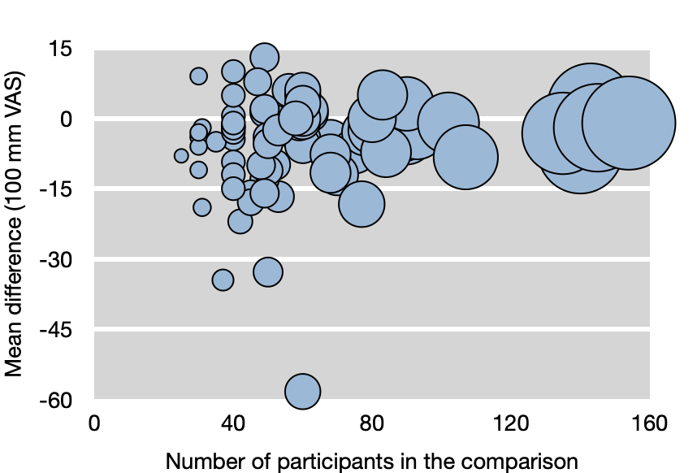
Pain at rest – effect of size
Graphic shows the mean difference (mm VAS) between treatment and placebo plotted against the total number of participants in the comparison
Size of symbol proportional to number of participants
Conclusion: there is only a small effect of size (number of participants) on pain at rest overall, but a few smaller trials appear to be outliers

Slide 8
Pain at rest – effect of size
Conclusion of no major effect of study size on result emphasized by pooled analysis conducted in various size bands
Small effect in smaller studies declines somewhat with larger size
But clinical significance of results across all sizes of study is debatable
Participants in comparison | Number of trials | Number of patients | Mean difference PI ketamine-placebo mm/100
20-40 | 22 | 789 | -5.3
41-60 | 33 | 1785 | -6.5
61-80 | 14 | 1009 | -5.0
81-100 | 6 | 529 | -1.6
101-154 | 7 | 926 | -2.7
Note that calculations performed on different basis to RevMan, using weighting by size

Slide 9
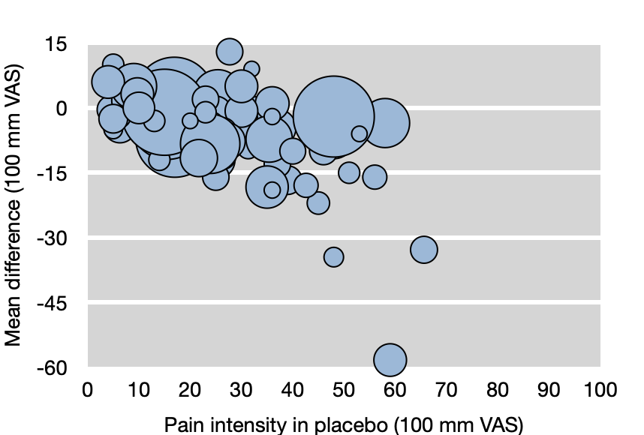
Pain at rest – effect of pain in placebo
Graphic shows the mean difference (mm VAS) between treatment and placebo plotted against pain intensity with placebo
Size of symbol proportional to number of participants
Conclude that there appears to be a trend with bigger effects where there was more pain with control

Slide 10
Pain at rest – effect of pain in placebo
Suggests that effectiveness of ketamine may be greater where there is more pain in the placebo group
Larger effect where pain with control was moderate or severe (≥ 40/100 mm), and little effect where there was little or no pain
Makes the result one of real clinical importance where pain is greater
Pain level with placebo Mm/100 | Number of trials | Number of patients | Mean difference PI ketamine-placebo mm/100
O-20 | 28 | 1883 | -1
21-30 | 33 | 1351 | -4
31-40 | 16 | 875 | -6
>40 | 14 | 860 | -14
Note that calculations performed on different basis to RevMan, using weighting by size

Slide 11
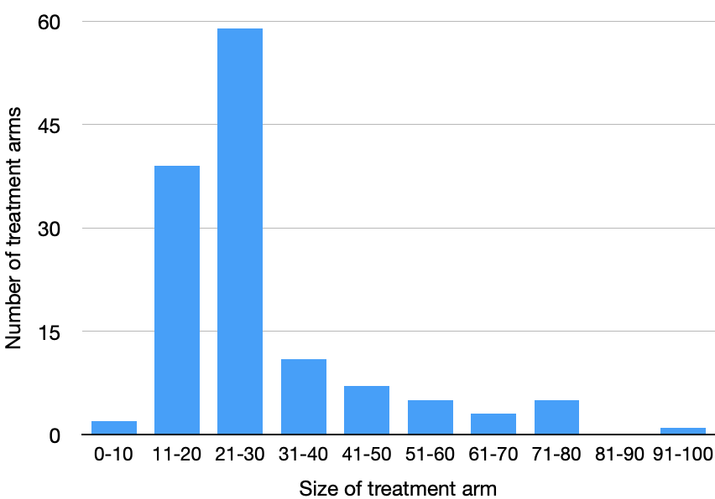
24-hour opioid consumption
This analysis depended on 65 RCTs with 4000 participants
Most ketamine or placebo trials arms involved small numbers of participants
The review concluded that ketamine reduced opioid consumption by about 8 mg morphine equivalent (6 to 9) with moderate quality evidence

Slide 12
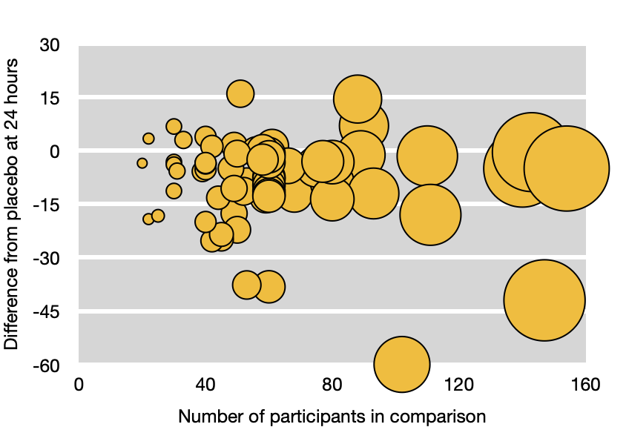
Opioid consumption – effect of size
Graphic shows the mean difference (mg morphine equivalent) between treatment and placebo plotted against the total number of participants in the comparison
Size of symbol proportional to number of participants
Conclude that there is only a small effect of size on opioid consumption overall, but a few smaller trials appear to be outliers

Slide 13
Opioid consumption – effect of size
Suggests no consistent effect of study size on result emphasized by pooled analysis conducted in various size bands
Analysis by study size show no consistent trends
Clinical significance of results is highly variable between groups
Participants in comparison | Number of trials | Number of patients | Mean difference ketamine-placebo mg morphine
20-40 | 17 | 552 | -5.1
41-60 | 30 | 1598 | -10.7
61-80 | 8 | 587 | -6.2
81-100 | 4 | 360 | +1.9
101-154 | 7 | 907 | -17.6
Note that calculations performed on different basis to RevMan, using weighting by size

Slide 14
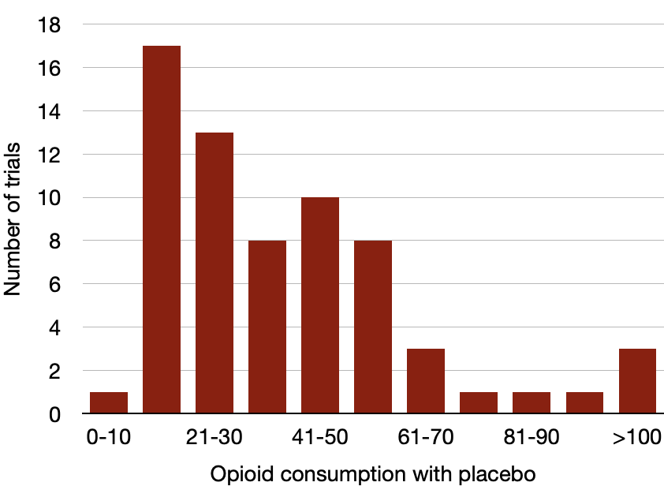
24-hour opioid consumption in placebo
Large degree of variability in terms of opioid consumption with placebo
From almost no consumption to > 100 mg morphine equivalent in 24 hours
Impossible to measure effect with low consumption
Is there a threshold?

Slide 15
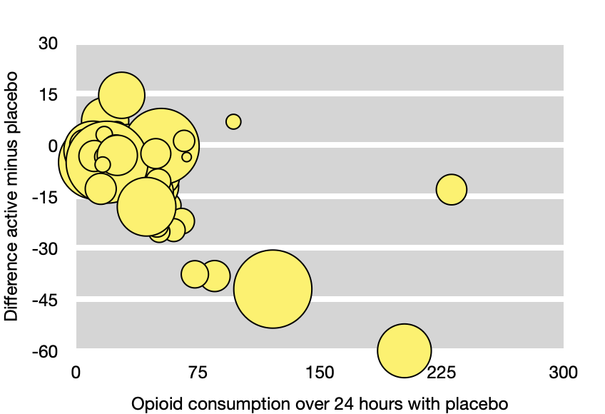
Opioid consumption in placebo
Graphic shows the mean difference (mg morphine equivalent) between treatment and placebo plotted against opioid consumption with placebo
Size of symbol proportional to number of participants
Conclude that there appears to be a trend with bigger effects where there was more opioid consumption with control

Slide 16
Opioid consumption in placebo
Conclusion of major effect of opioid consumption in control groups emphasized by a sensitivity analysis
Larger effect where pain with control was above 40 mg/24 hours, and little effect where it was below 40 mg/24 hours
Makes the result one of real clinical importance where higher opioid consumption is expected (prior use of opioids for chronic pain)
24 hr opioid consumption with placebo (mg morphine) | Number of Trials | Number of Participants | Mean reduction (mg morphine)
0-20 | 18 | 1155 | -4
20-40 | 21 | 1209 | -2
40-60 | 16 | 987 | -12
60-100 | 8 | 345 | -22
>100 | 3 | 308 | -42
Note that calculations performed on different basis to RevMan, using weighting by size

Slide 17
Conclusions
More detailed sensitivity analyses demonstrate that there can be large and clinically significant effects on pain-related outcomes depending on features of design or results of included studies
In this case these were related to event rates in control for pain and analgesic consumption
Other examples have shown study size to be important
The take-home message is to be aware that, for pain outcomes, there are important criteria of inclusion and/or analysis that are not found in the Cochrane Handbook

Slide 18
Acknowledgements
Thank you to the Cochrane Network Innovation Fund
Thank you to Mohammed A. Abusayed (University Hospitals of Derby and Burton, UK) for auditing reviews of interventions for pain in the Cochrane Library in 2016
Thank you to all the project team members and MOSS key contacts
Joanne Abbott; Geert Crombez; Rob Dellavalle; Christopher Eccleston; Anna Erskine; Emma Fisher; Kerry Harding; Jennifer Hilgart; John Lawrenson; Hopin Lee; Nuala Livingstone; Lara Maxwell; Andrew Moore; Gill Norman; Neil O'Connell; Roses Parker; Phil Riley; Kate Seers; Teo Aminah Wasteneys Quay; Andrew Smith; Martin Tramèr; Peter Tugwell; Katie Webster; Amanda C de C Williams
All the slides and documents hosted on the PaPaS website https://papas.cochrane.org/resources/acute-pain-outcomes

