Slide 1
Rapid Reviews and “rapid” Systematic Reviews: what do we do about them?
Dr Andrew Booth, ScHARR, University of Sheffield, UK and Cochrane Qualitative and Implementation Methods Group

Slide 2
Conflict of Interest Statement
I have no actual or potential conflict of interest in relation to this presentation

Slide 3
Outline
Rapid Reviews – The Challenges
Lines for Exploration
Future Directions?

Slide 4
Rapid Reviews – Abbreviated or Accelerated
Abbreviated: “Cutting Corners” but
Which corners to cut?
What are the methodological implications of cutting corners?
Accelerated: “Working Smarter” but
Which technologies to use?
What are the workflow implications of working smarter?

Slide 5
“Cutting Corners”
Lines for Exploration
How few Databases are enough?
Role of Citation Searches – for Reviews and for Updates
What are “reasonable norms” for search results/yields?
“Working Smarter”
Role of Supplementary Searching
Publish or Perish Software

Slide 6
What do we already know?
Item | Number Screened | Number Included | Number Needed to Retrieve
94 systematic reviews (Sampson et al, 2011) | 189334 | 5734 | 33
Nichol et al., 2004 | 10578 | 254 | 42
Gulmezoglu et al., 2004 | 64586 | 2443 | 26
Average no. of references per review = 2,014

Slide 7
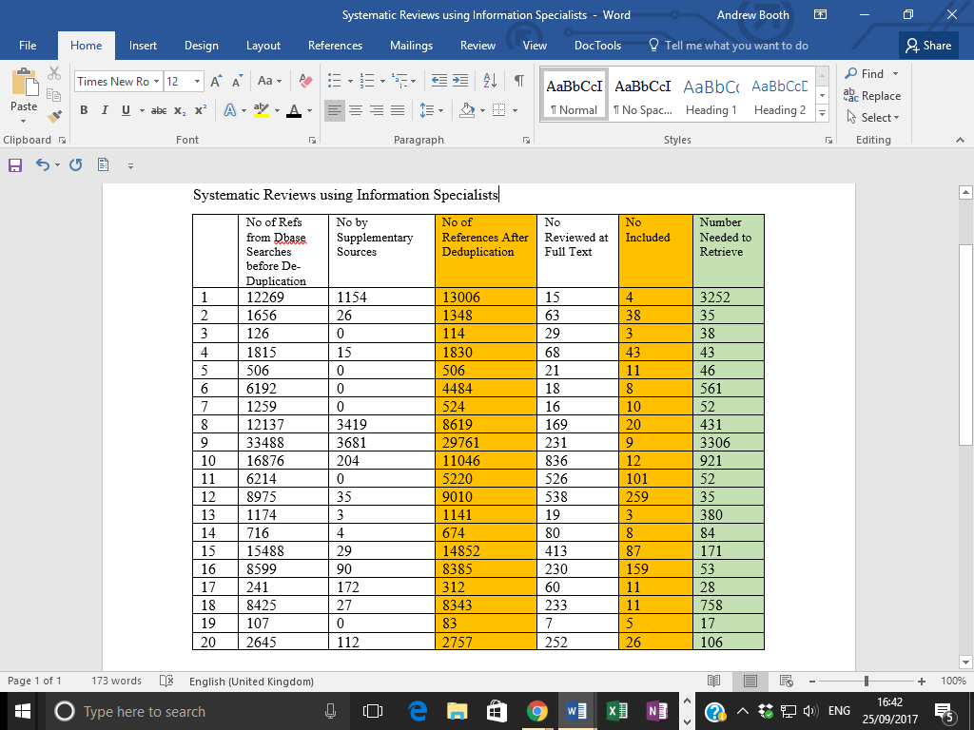
(Original Data – Booth, 2017)

Slide 8
From “Opportunistic” Sample (n = 20) on Google Scholar (All using Info Scientist)
Mean Number of References per Review = 6100 References (almost 3 times Sampson sample)
Mean Number of References to Screen per Included Paper = 147 References (Almost 4.5 times Sampson Sample)

Slide 9
Methods for this Study
5 most recently published Cochrane Public Health Reviews
5 most recently published reviews on NIHR Journals Library for each of the 9 NICE TAR teams:
  Aberdeen HTA Group, University of Aberdeen
  BMJ Technology Assessment Group (BMJ-TAG)
  Centre for Reviews and Dissemination/Centre for Health Economics, University of York
  Kleijnen Systematic Reviews Ltd
  Liverpool Reviews and Implementation Group, University of Liverpool
  PenTAG, Evidence Synthesis & Modelling for Health Improvement (ESMI), University of Exeter
  School of Health and Related Research, University of Sheffield
  Southampton Health Technology Assessments Centre, University of Southampton
  Warwick Evidence, University of Warwick
  (NB. Reviews could be but were not necessarily TAR reports)

Slide 10
The Bottom Line
Cochrane PH Reviews – Mean Number of References per Review = 25,151 (Range = 7,804 - 50,270)
Cochrane PH Reviews – Mean Number Needed to Retrieve = 860 (Range = 234- 1795) Between 2 – 15 hours sifting for each Included Paper
TAR Teams – Mean Number of References per Review = 6,328 (Range = 73 – 102267)
TAR Teams – Mean Number Needed to Retrieve = 269 (Range = 6 – 2646) [NB 1 Review = NO included studies from 3644 references]
Between 3.5 mins – 22 hours sifting for each Included Paper

Slide 11
By Institution
Institution | Mean Refs | Mean NNR | Institution | Mean Refs | Mean NNR
COCHRANE PH | 25,151 (7,804 - 50,270) | 860 (234 – 1,795) | EXETER | 3,693 (724 – 10,753) | 165 (16 - 392)
LIVERPOOL | 24,039 (190 -102,267) | 226 (29 - 846) | WARWICK | 3,555 (73 – 13,627) | 52 (6 – 121)
SHEFFIELD | 7,545 (2,724 - 16,591) | 652 (36 – 395) | YORK | 3,368 (1,961-4,516) | 81 (15 – 181)
KLEIJNEN | 7,364 (3,524 – 9,870) | 235 (98 – 431) | SOTON | 1,913 (655 – 2,628) | 189 (65 – 329)
BMJ | 4,101 (1,428 – 6,079) | 105 (8 - >3,644) | ABERDEEN | 1,372 (658 – 2,952) | 73 (15 - 173)

Slide 12
By Institution (Time Per Relevant Record)
Institution | Mean NNR | MEAN TIME | Institution | Mean NNR | MEAN TIME
COCHRANE PH | 860 (234 – 1,795) | 7 Hrs | EXETER | 165 (16 - 392) | 1.5 Hrs
LIVERPOOL | 226 (29 - 846) | 2 Hrs | WARWICK | 52 (6 – 121) | 0.5 Hrs
SHEFFIELD | 652 (36 – 395) | 5.5 Hrs | YORK | 81 (15 – 181) | 0.6 Hrs
KLEIJNEN | 235 (98 – 431) | 2 Hrs | SOTON | 189 (65 – 329) | 1.5 Hrs
BMJ | 105 (8 - >3,644) | 1 Hr | ABERDEEN | 73 (15 - 173) | 0.6 Hrs

Slide 13
Implications to Date
Little Evidence of “Community Norms” on Acceptable Result Sets or Numbers Needed to Read
Considerable Variation in Means and Ranges
Clear Difference in Expectations between Cochrane (Public Health) Reviews and NIHR HTA Products
Some Evidence for “Institutional Norms” (although different Information Specialists involved; some without Info Specialists)
Some Evidence that Information Specialists are associated with more Efficient Searches, No Info Specialist with less Efficient Searches

Slide 14
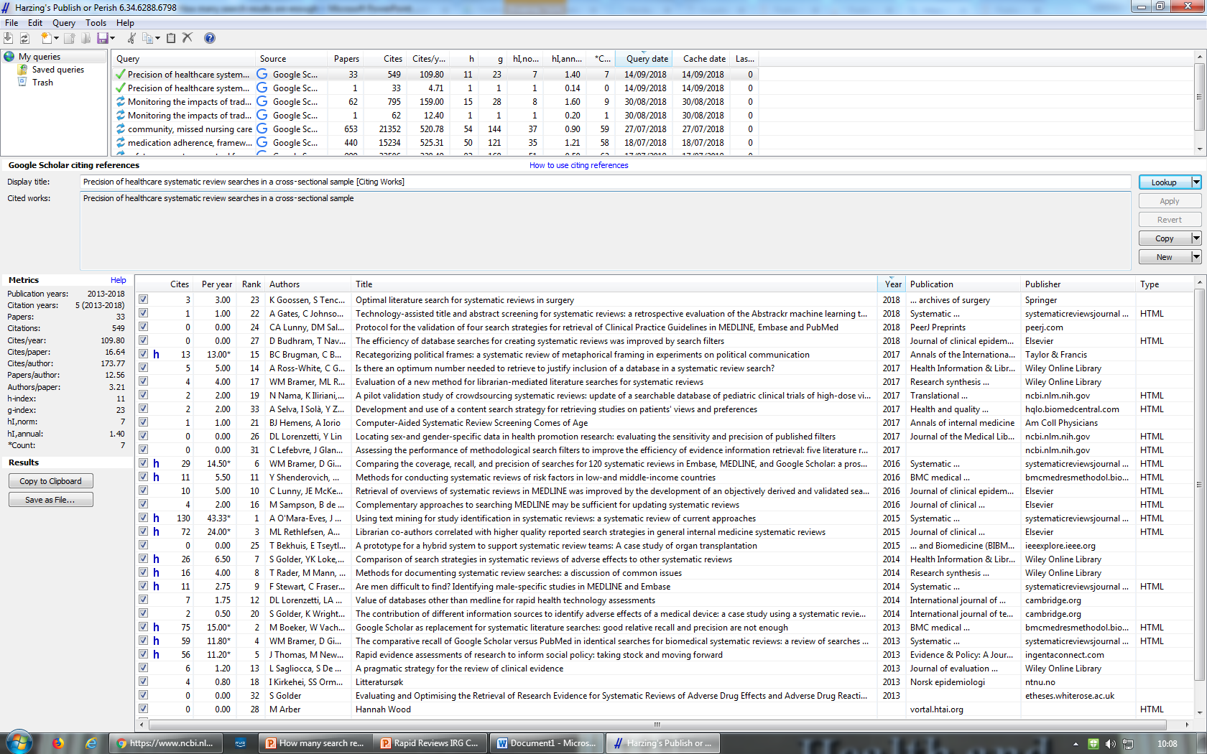
Publish or Perish Version 6.0
https://harzing.com/resources/publish-or-perish
Potential for finding more relevant studies earlier in review process

Slide 15
Supplementary Search Methods
Cooper C, Lovell R, Husk K, Booth A & Garside R (2017) Supplementary search methods were more effective and offered better value than bibliographic database searching: A case study from public health and environmental enhancement. Research Synthesis Methods.
Bibliographic databases approach: 21 409 studies to screen and 2 included qualitative studies were uniquely identified. Study quality was moderate, and contribution to the synthesis was minimal.
Supplementary search approach: 453 studies to screen and 9 included studies were uniquely identified.
CERQual Verdicts: Four quantitative studies were poor quality but made a substantive contribution to the synthesis; 5 studies were qualitative: 3 studies were good quality, one was moderate quality, and 1 study was excluded from the synthesis due to poor quality. All 4 included qualitative studies made significant contributions to the synthesis.

Slide 16
The Way Forward?
Legitimised move to fewer databases?
Greater share of data on database yield (cp. Alison Bethel documentation)
Greater sharing of data on retrieval effectiveness (e.g. by discipline, topic, institution, review type etc)
Greater agreement on “norms” for search results and numbers needed to read/retrieve?
Greater exploration of citation searching as a complementary strategy (more recent, diffuse terminology etc.) [but Numbers Needed to Read are high for citation searching too!]

Slide 17
References
Booth, A. (2016). Over 85% of included studies in systematic reviews are on MEDLINE. Journal of clinical epidemiology, 79, 165.
Bramer WM, et al (2016). Comparing the coverage, recall, and precision of searches for 120 systematic reviews in Embase, MEDLINE, and Google Scholar: a prospective study. Systematic Reviews; 2016 Mar 1;5(1).
Halladay, C. W., et al (2015). Using data sources beyond PubMed has a modest impact on the results of systematic reviews of therapeutic interventions. Journal of clinical epidemiology, 68(9), 1076-1084.
Nussbaumer-Streit B, Klerings I, Wagner G, Heise TL, Dobrescu AI, Armijo-Olivo S, Stratil JM, Persad E, Lhachimi SK, Van Noord MG, Mittermayr T, Zeeb H, Hemkens L, Gartlehner G. Abbreviated literature searches were viable alternatives to comprehensive searches: a meta-epidemiological study. J Clin Epidemiol. 2018 Oct;102:1-11. doi: 10.1016/j.jclinepi.2018.05.022.
Sampson M, Tetzlaff J, Urquhart C. Precision of healthcare systematic review searches in a cross-sectional sample. Research Synthesis Methods; 2011 Jun;2(2):119–25. Available from: http://dx.doi.org/10.1002/jrsm.42

