Slide 1
SuRe Info

Slide 2
What is SuRe Info?
Open access web resource, established in 2012
Initiative from HTAi Information Retrieval Group (IRG)
Project management by Julie Glanville
Chapters produced by information specialists
Update twice a year
AIM: provide an overview of current evidence

Slide 3
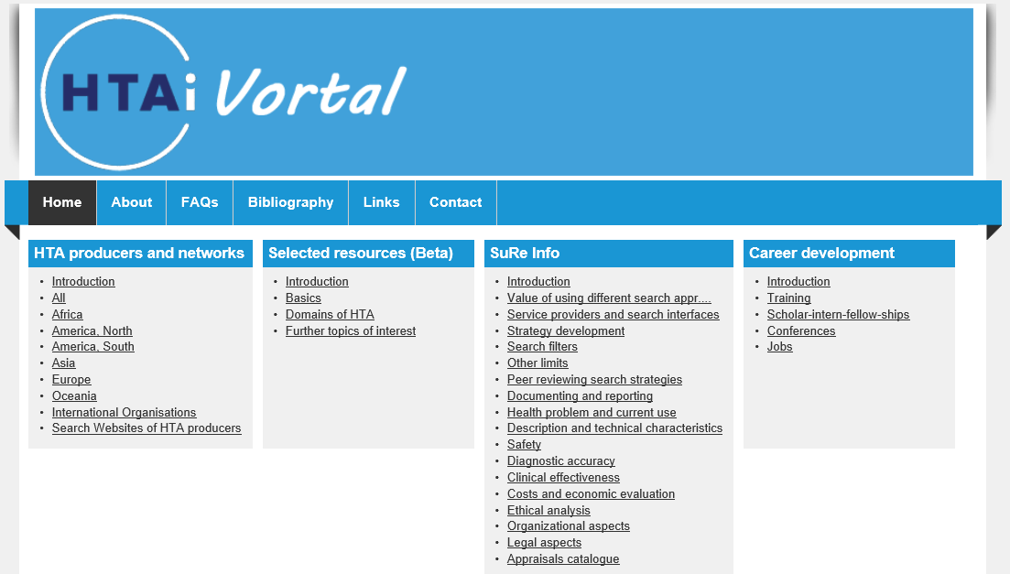
http://vortal.htai.org/

Slide 4
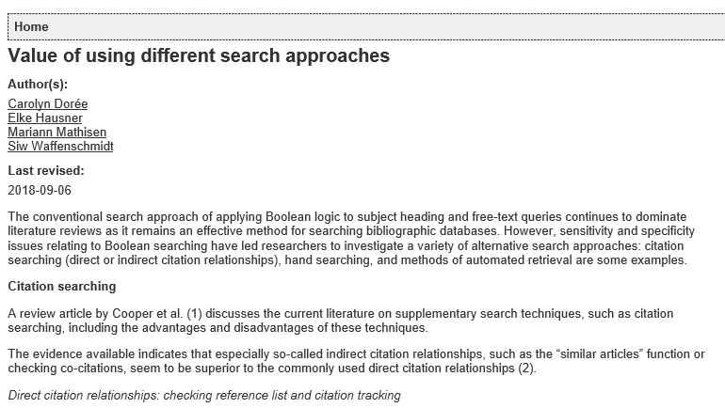
http://vortal.htai.org/index.php?q=node/993

Slide 5
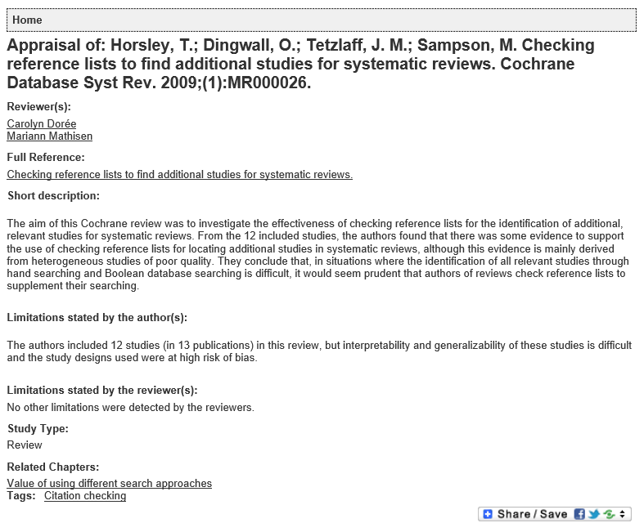
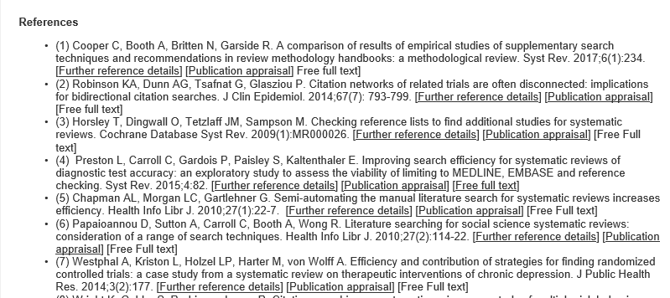

Slide 6
Institute for Quality and Efficiency in Health Care (IQWiG)
Institut für Qualität und Wirtschaftlichkeit im Gesundheitswesen (IQWiG)
Im Mediapark 8
D-50670 Cologne
Telefon +49 221 35685-0
Telefax +49 221 35685-1
info@iqwig.de
www.iqwig.de
www.informedhealth.org
www.themencheck-medizin.iqwig.de
Twitter: @iqwig und @iqwig_gi
6

Slide 7
Thanks to all the authors so far…
Anita Fitzgerald
Carol Lefebvre
Caroline Higgins
Carolyn Dorée
Corinne Holubowich
Dagmara Chojecki
David Kaunelis
Elke Hausner
Hannah Wood
Ingvild Kirkehei
Jaana Isojärvi
Julie Glanville
Kath Wright
Kristin Bakke L.
Lisa Tjosvold
Mariann Mathisen
Mick Arber
René Spijker
Sari Susanna Ormstad
Sigrid Droste
Siw Waffenschmidt
Steven Duffy
Su Golder

