Slide 1
What’s New in the
Cochrane Library
Colleen Finley
Product Manger, Search and Discovery Wiley
Photo by Holly Millward
Notes:
I am going to talk to you briefly about Cochrane as an organisation; its global reach, its role in providing independent evidence to support clinical decision-making and why your users would benefit from being involved. I am then going to tell you a little bit about the CENTRAL database that supports the production of Cochrane Reviews and the initiatives of librarians to improve searching for randomized controlled trials and controlled clinical trials. Finally I am going to talk about our initiatives to improve accessibility of Cochrane Reviews so that high-quality evidence is used more frequently to guide clinical practice

Slide 2
New Cochrane Library - Benefits
Integrate new content
More consistent user experience
Provide better links within our content
Support search faceting
Better access to translated content
Available at cochranelibrary.com
Notes:
Consolidated view of all Cochrane content to:
enable a more consistent user experience
link our content
integrate new content (e.g. Cochrane Clinical Answers)
innovate faster (in ongoing future releases)
Provide better access and visibility to translated content (including a new Spanish portal)

Slide 3
Content
Cochrane Database of Systematic Reviews
Central Register of Controlled Trials (CENTRAL)
Cochrane Clinical Answers
Systematic Reviews from Epistemonikos
Editorials
Special Collections
NEW
NEW
All content accessible through a single search

Slide 4
Content Changes
Retired CRD Databases
Database of Reviews of Effects (DARE)
NHS Economics Evaluation Database (EED)
Heath Technology Assessments (HTA)
“About database” replaced with direct links to Cochrane Group websites

Slide 5
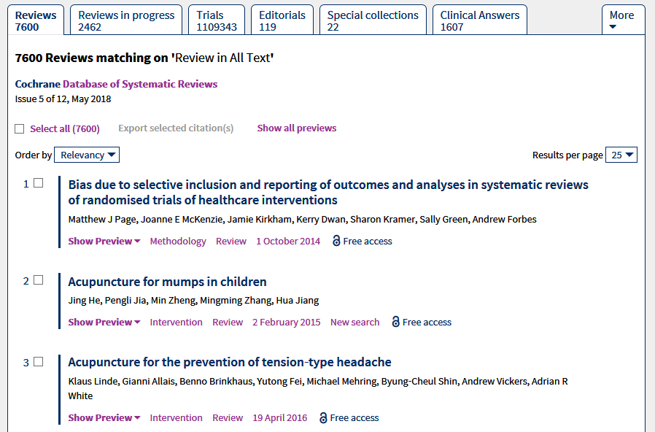
Access all content with a single search
Notes:
There is a question and Clinical Answer

Slide 6
Site Navigation and Search
Many existing navigation features remain
Browse options for Cochrane Reviews
By Topic
By Cochrane Review Group
Search Options
Basic Search on Homepage
Search Tab
MeSH
Search Manager

Slide 7
Search Results now include faceting
Notes:
Under each outcome, you have an assessment of the quality of the evidence and full details of the statistical results

Slide 8
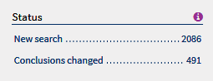
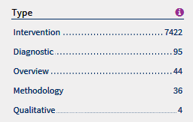
Facets specific for Cochrane Reviews
Status: Filters by events that have effected the review
Type: Used to identify the type of question addressed by the review
Notes:
Under each outcome, you have an assessment of the quality of the evidence and full details of the statistical results

Slide 9
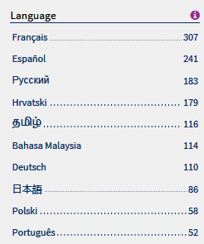
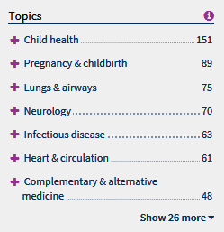
Facets specific for Cochrane Reviews
Language: Identifies when translations for content are available
Topic: Limit results based on Cochrane supplied topics
Notes:
Under each outcome, you have an assessment of the quality of the evidence and full details of the statistical results

Slide 10
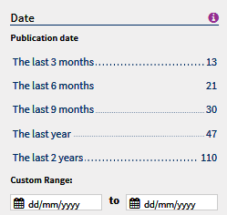
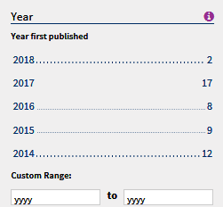
Additional Facets
Date article was published online or added to the Cochrane Library
Publication year (CENTRAL only). Original Publication year for a CENTRAL article
CENTRAL only
Limit results to articles sourced from PubMed or Embase
Notes:
Under each outcome, you have an assessment of the quality of the evidence and full details of the statistical results

Slide 11
New – Search Manager Slideouts
Use the S button to access slideout allowing users to select fields using menus directly in search manager
Allows users to make all entries on the same page
Notes:
Under each outcome, you have an assessment of the quality of the evidence and full details of the statistical results

Slide 12
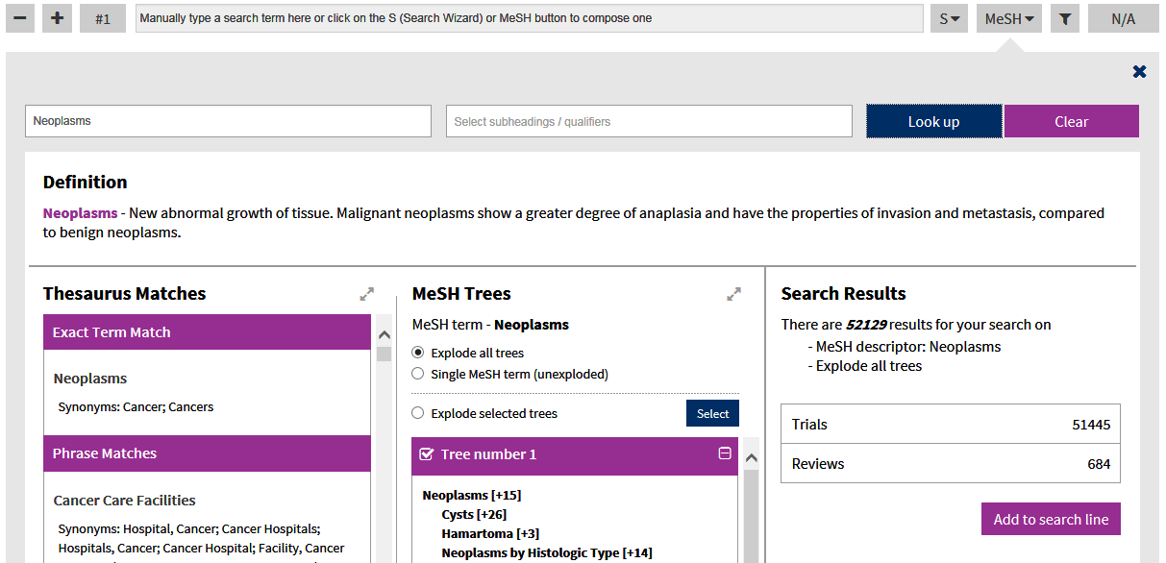
New – Search Manager Slideouts
Use the Mesh button to access slideout allowing users to add Mesh using the browser
Allows users to make all entries on the same page
Notes:
Under each outcome, you have an assessment of the quality of the evidence and full details of the statistical results

Slide 13
Many New Links between content
Cochrane Database of Systematic Reviews
CENTRAL
Article
References
How Cochrane Used this article
Characteristics of studies
Article
Cochrane Clinical Answers
Related Content
Cochrane Podcasts
Guidelines
Notes:
Click-to-expand function allows you to view further information
The Population, Intervention, Comparator section at the bottom of the page describes people and interventions included in the trials to aid you in determining clinical relevance

Slide 14
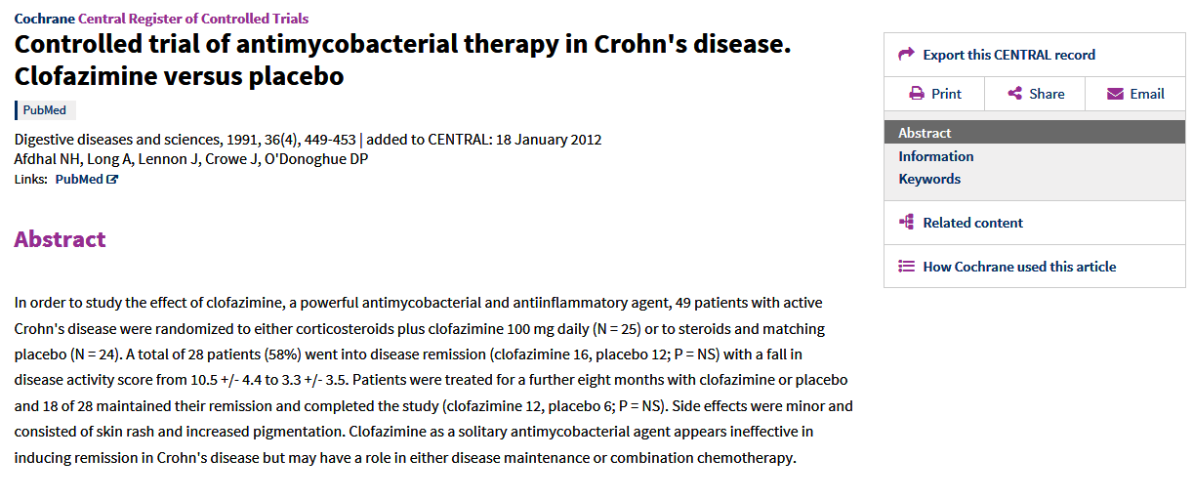
LINKED CONTENT
See how a CENTRAL article was used in specific Cochrane Reviews
Notes:
There is a question and Clinical Answer

Slide 15
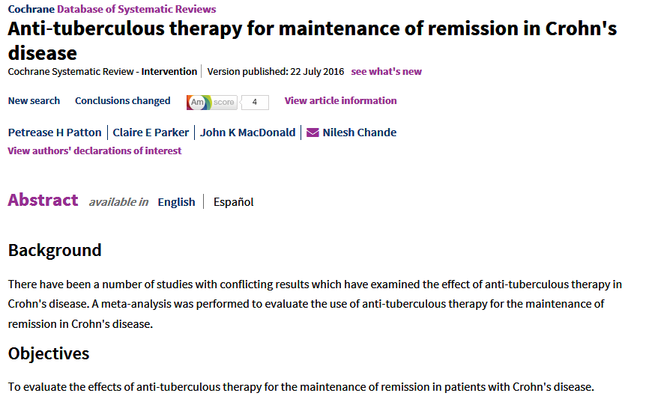
LINKED CONTENT
Select the title to link to the Cochrane Systematic Review the CENTRAL article was used in.
Notes:
There is a question and Clinical Answer

Slide 16
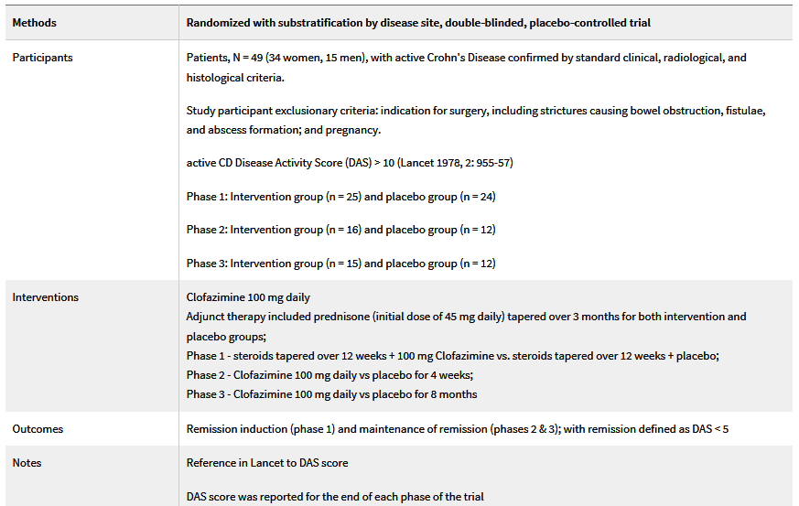
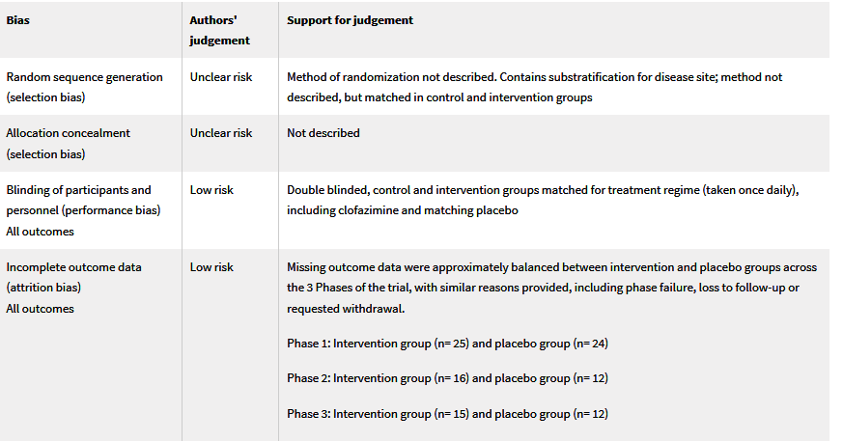
LINKED CONTENT
Use this link to view the Cochrane PICO analysis and risk of bias for the article
Notes:
There is a question and Clinical Answer

Slide 17
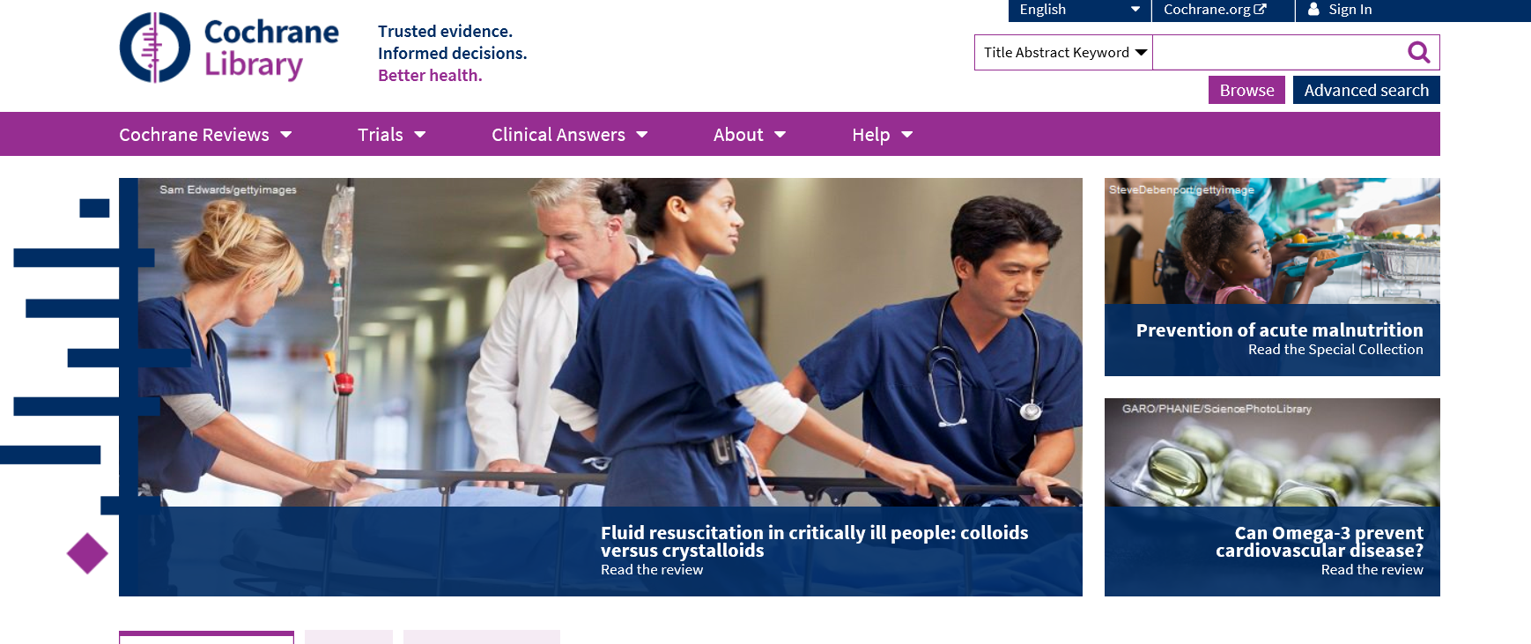
Getting help

Slide 18
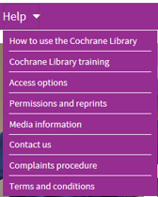
Learn more
Search guides, live webinars, training videos, and more are available from the “Help” menu on the Cochrane Library homepage.

