Slide 1
A comparison of different forward citation chasing tools for complementary searches for Cochrane systematic reviews
Bracchiglione J¹, Requeijo C², Santero M², Savall O², Selva A³, Samsó L², Roqué-Figuls M², Escobar Liquitay C⁴, Solà I¹
¹Institut d’Investigació Biomèdica Sant Pau (IIB SANT PAU), CIBERESP, Barcelona, Spain
²Institut d’Investigació Biomèdica Sant Pau (IIB SANT PAU), Barcelona, Spain
³Clinical Epidemiology and Cancer Screening, Parc Taulí Hospital Universitari. Institut d’Investigació i Innovació Parc Taulí (I3PT_CERCA), Sabadell, Spain
⁴Associate Cochrane Centre - Research Department, Instituto Universitario del Hospital Italiano de Buenos Aires, Buenos Aires, Argentina

Slide 2
Conflict of interest
I have no actual or potential conflict of interest in relation to this presentation.

Slide 3
Introduction
Forward citation chasing is the use of a citation index to retrieve references that cite a source.
Currently recommended as a complement to find all possibly relevant research for systematic reviews (SRs)
Recently, new tools have been developed to ease this task, but their performance has not been compared yet.

Slide 4
Objective
To estimate and compare the performance of different resources for forward citation searching in the context of conducting updates of systematic reviews (SRs).
As a secondary objective, we aim to explore how efficient a forward citation search strategy could be by itself as a way to update a SR, compared to a traditional boolean search strategy in electronic databases.

Slide 5
Methods
We included Cochrane SRs with at least two published versions
‘Original’ version: First version of the SR within the Cochrane Database of Systematic Reviews.
‘Updated’ version: Most recent version of the same SR.
The ‘original’ SR must have included at least one primary study.
The ‘updated’ SR must have included at least one additional new primary study in respect to the ‘original’ version

Slide 6
Methods
Index reference set
Target reference set
References of the included primary studies in the original SR
Tool
References of the new included primary studies in the updated SR
Reference of the original SR itself
WoS
Scopus
GoogleScholar
Citationchaser
Paperfetcher
Citationcloud

Slide 7
Results

Slide 8
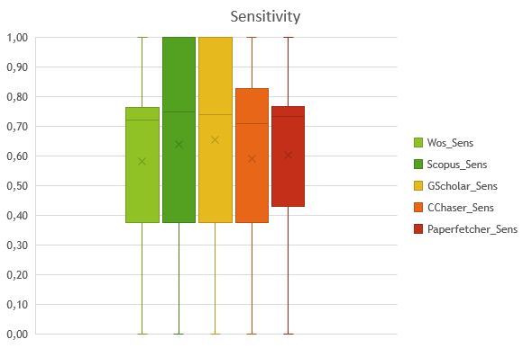
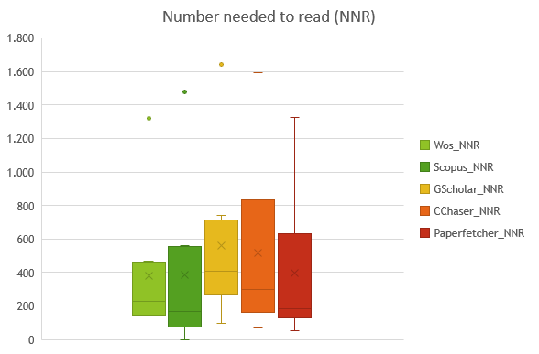
Results
Tool | Mean sensitivity (95% CI) | Mean precision (95% CI) | Mean NNR (95% CI)
WoS | 0.58 (0.34 – 0.82) | 0.0041 (0.0011 - 0.0072) | 382 (44.7 – 719)
Scopus | 0.64 (0.37 – 0.91) | 0.0046 (0.0007 - 0.0084) | 423 (32.8 – 812)
Google Scholar | 0.66 (0.38 – 0.93) | 0.0026 (0.0005 - 0.0047) | 563 (158.2 – 967)
Citationchaser | 0.59 (0.35 – 0.84) | 0.0037 (0.0006 - 0.0067) | 516 (84.9 – 947)
Paperfetcher | 0.60 (0.36 – 0.84) | 0.0048 (0.0008 - 0.0087) | 399 (39.1 – 759)
So far, 10 pairs of SRs analysed.
Median index reference set: 7 (range: 3 - 13)
Median target reference set: 4 (range: 1 - 11)

Slide 9
Discussion
Google Scholar showed the best sensitivity, but the highest NNR.
WoS showed the lowest NNR, although it had 8% less sensitivity than Google Scholar.
Scopus seems to have the better balance among sensitivity and precision.
Limitation: Analysis may be influenced by reviews with one or few new primary studies in the updated SRs.
There is no citation tool with a better performance over the rest.
Forward citation search could not be used as a stand alone method to update SR.

Slide 10
Thank you Contact information: javier.bracchiglione@gmail.com @JBracchiglione

