Slide 1
Information specialists - barriers and facilitators to career progression and methodology research
Madeleine Still, Oleta Williams, Britzer Paul Vincent, Eugenie Johnson, Catherine Richmond, Sean Gill, Fiona Beyer, Fiona Pearson, Fiona Campbell, Sheila Wallace
NIHR Innovation Observatory/Evidence Synthesis Group, Newcastle University, UK
Notes:
Introduce us

Slide 2
Conflict of interest
We have no actual or potential conflict of interest in relation to this presentation
This project was seed corn funded by the National Institute for Health and Care Research (NIHR) via the Methodology Incubator Information Retrieval Specialist Workstream (ISF/01/2022/16)
The Methodology Incubator and project are funded by the NIHR. The views expressed are those of the authors and not necessarily those of the NIHR or the UK Department of Health and Social Care
Notes:
We have no conflicts of interest, the project is funded but the presentation is our own personal views

Slide 3
Contents
Background and aims of the project
Methods – survey and workshop
Main results
Recommendations
Notes:
Very quick

Slide 4
Background
NIHR Methodology Incubator aims to increase research capacity in methodology applied to health and care research
Data management
Identification of data sources
“Information Retrieval Specialists”
Complex searching
Academic writing or other outputs
Notes:
We are part of the NIHR Methodology Incubator, which funded this work and aims to increase research capacity in methodology applied to health and care research. We obtained some funding to look at research capacity and career progression for information specialists who carry out ‘expert searching’ roles within health and social care – typically including identification of appropriate sources of data; complex searching of structured data like bibliographic databases or trial registries and unstructured data like websites or file repositories; data management; reporting or writing for academic journals and other outputs8. This could include IRS working on systematic reviews or guidelines, or providing a clinical information service.
This can be the main element of the role or a much smaller part.
These functions are sometimes but not always associated with career progression
Information Retrieval Specialists and other methodologists are an integral part of research but may find it difficult to undertake research or progress their careers in their current positions. Lack of advancement of research methods may slow research overall.

Slide 5
Background
Information Retrieval Specialists and other methodologists are an integral part of research but may find it difficult to undertake research or progress their careers in their current positions. Lack of advancement of research methods may slow research overall.

Slide 6
Aims
Identify barriers and enablers to career progression and methodological research for UK-based information retrieval specialists in health and social care
Identify solutions to the reported barriers

Slide 7
Methods and Results 1
(n = 170)
Survey (March – April 2023)
Demographic and career history information
Barriers and enablers to career progression and research
(n = 14)
Focus group (17 May 2023) - online
Brainstormed solutions to the barriers
Notes:
Survey was designed in Qualtrics, piloted with local information specialists, distributed through mailing lists, contacts, networks, twitter, LinkedIn, FaceBook, included questions about demographics, careers, research, experience, development.
Focus group was held virtually to increase potential for attendance from a distance. The results of the survey were presented and then participants split into groups of 4-5 to discuss

Slide 8
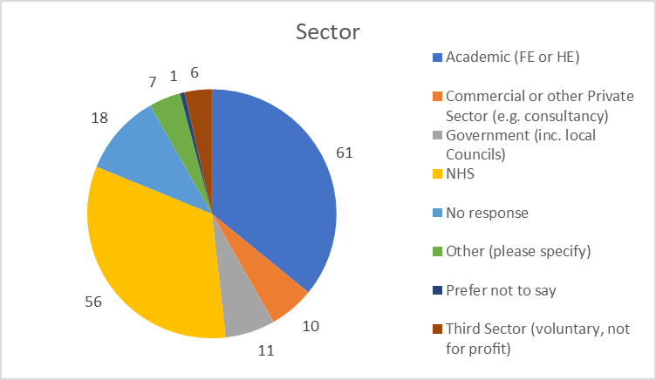
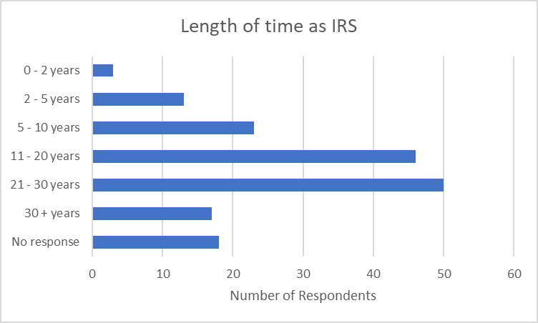
Results 2 – Survey respondents
Sector
Length of time as IRS
Numbers of respondents by sector
Number of respondents
Notes:
In both the survey and focus groups, participants comprised mostly academic and NHS sector, with smaller numbers from commercial, voluntary and government sectors, and they had mostly more than 11 years experience, not so many early career researchers.

Slide 9
Results 3 – Barriers and Enablers
Barriers
Enablers
Isolation
Skill set not being valued by organisation
Lack of recognition despite contribution
Networking
Stay in touch throughout lifecycle of project
Mentoring/shadowing

Slide 10
Solutions – specific to ‘expert search’ role
Competency framework
Methodological research
Community of Practice
Advocacy at a local, organisational and national level
Authorship
Continuing Professional Development
Notes:
Community of Practice – build on and work with existing groups like Cochrane IRMG and NICE ISSG, the Methodology Incubator Information Specialists Workstream, virtual groups like LISSEARCHERSCOP mailing list. Create a single space to signpost CPD opportunities, facilitate mentoring opportunities and networking.
Competency framework specific to expert searching domain – again there are resources in this space but not known or accessible to all.
Methodological research and development specific to expert searching domain – there is excellent work going on in this space and we need to work to emphasise its importance so that time and funding are made available
Info specialists need to work with employers and professional organisations to ensure that CPD is formally acknowledged and resourced
IRS should be familiar with authorship requirements from ICJME and publishers, who should require the inclusion of IRS authors where complex searches have been undertaken
IRS should advocate for themselves and team and departmental level. They need to work with employers individually and through Community of Practice/professional organisations to advocate at organisational and national level

Slide 11
Methodology Incubator Information Retrieval Specialist Workstream
Thank you
Contact: fiona.beyer@newcastle.ac.uk or sheila.wallace@newcastle.ac.uk
Notes:
We will be exploring how to take these ideas forward through the Methodology Incubator Info Retrieval Specialist Workstream, in collaboration with others.
Thank you for listening and to all the people that filled in the survey and attended the workshop.

