Slide 1
The InterTASC Information Specialists' Sub-Group (ISSG) Search Filter Resource: update and recent developments
Information Retrieval Methods Group Annual meeting
Cochrane Colloquium, London, September 2023
Paul Manson Information Specialist Health Services Research Unit University of Aberdeen, UK

Slide 2
Background
In 2006, the ISSG Search Filter Resource (SFR) was developed by Information Specialists supporting evidence synthesis projects for the UK National Institute for Health and Care Excellence (NICE).
Its aims are to:
improve awareness of filters
reduce duplication of effort
provide a forum for critical appraisal
provide a ‘one-stop-shop’ for the identification of methodological search filters.

Slide 3
Methods
The editorial team carry out monthly searches of:
CINAHL, Embase and MEDLINE
journal TOC, current awareness lists, and websites.
Potentially eligible filters are agreed by two team members prior to inclusion.
Notes:
Editors are information specialists

Slide 4
Current editorial team
Julie Glanville, Independent Consultant, Glanville.info, UK
Carol Lefebvre, Independent Information Consultant, Lefebvre Associates Ltd, UK
Paul Manson, Information Specialist, Health Services Research Unit, University of Aberdeen, UK
Sophie Robinson, Information Specialist, PenTAG/HS&DR, ESMI, University of Exeter, UK
Igor Brbre, Information Scientist, Healthcare Improvement Scotland, UK
Lois Woods, Senior Research Assistant, Southampton Health Technology Assessments Centre, UK
Notes:
Editors are information specialists

Slide 5
Content
The site contains
bibliographic references to published filters (study designs, population groups, geographic areas, health care settings, etc.)
contact information for developers of unpublished filters
independent abstracts and structured critical appraisals for some of the methodological search filters
references to research on the design, development and use of filters
references to studies reporting comparative data from independent testing of filters
links to collections of non-methodological clinical-topic-specific ‘filters’ or ‘search blocks’.
Notes:
with links to the PubMed record or full-text where available on open access
drafted by ISSG members

Slide 6
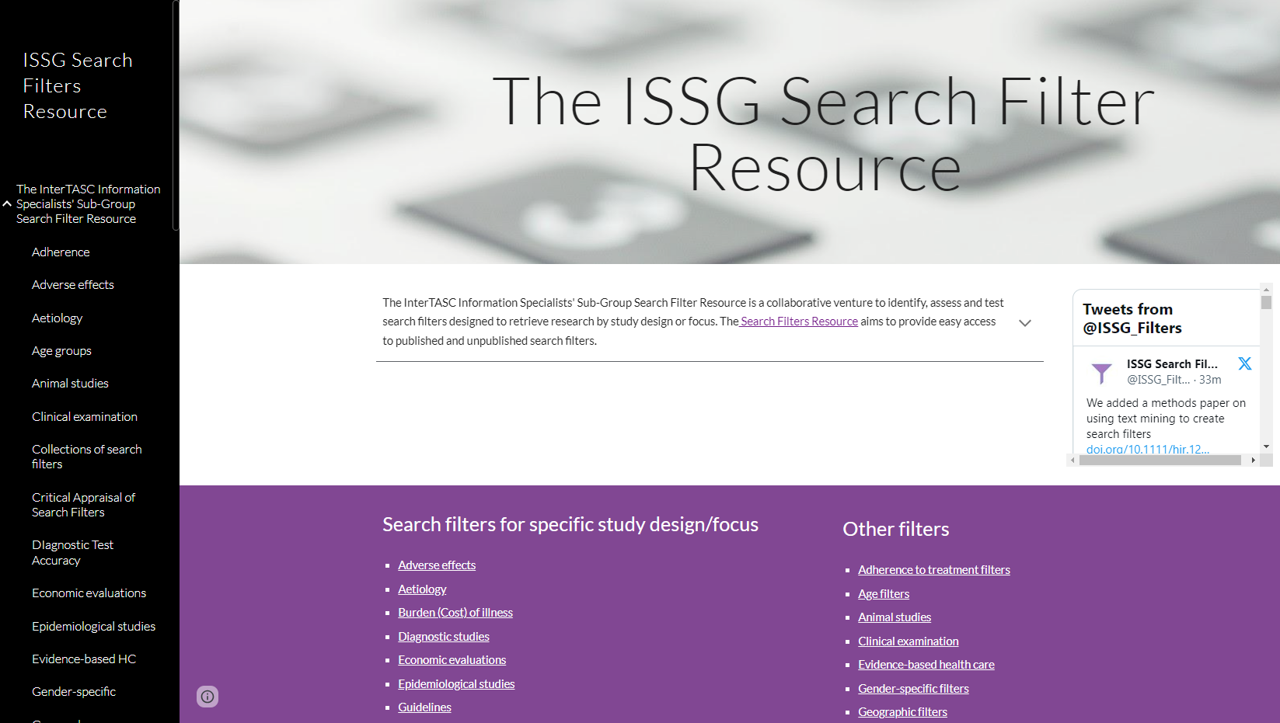

Slide 7
Search filters by study design/focus
Adverse effects
Diagnostic studies
Economic evaluations
Guidelines
Health services research
Mixed methods studies
Observational studies / real world data
Prognosis and Prediction Studies
Public or Patient Views
Qualitative research
Quality of life
RCTs and other trials
Systematic reviews
Other filters
Age filters
Animal studies
Evidence-based health care
Gender-specific filters
Geographic filters
Health applications (apps)
Health care settings
Off-label drug use
Patient safety filters
Population group filters
Prescribing, deprescribing
Quality improvement
Sample size

Slide 8
Search filters and related information added in 2023 (21 in total)
Revision of Cochrane MEDLINE (Ovid) RCT filters
Revision of Cochrane Embase RCT filters
2023 Cochrane LMIC filter
University of Alberta Libraries filters for various geographic areas
Search filter on patient-based benefit-risk assessment of medicines
Search filter to identify US studies
Performance review of deprescribing filters
Methods paper using text mining to create search filters

Slide 9
Recent and future developments
Site enhancements with additional value-added information such as:
links to automatically launch search filters
links to comments, errata and retractions of published filters
visual presentations of comparative performance data.
Notes:
automate this element of the search strategy development and to save time and reduce errors:

Slide 10
Visual presentations of comparative performance data – Prognosis filters

Slide 11
Conclusions
The ISSG Search Filter Resource (SFR) has provided access to search filters since 2006.
Recent and future developments are making it even more useful and efficient in identifying search filters.
Feedback is very welcome e.g.:
information about filters not currently listed on the site
results of independent testing of existing filters
comments on usability of the site
errors / broken links.
Notes:
Wider site promotion.

Slide 12
Please visit the site at:
https://sites.google.com/a/york.ac.uk/issg-search-filters-resource/home
X: @ISSG_Filters
Email (feedback): Julie Glanville: julie@glanville.info
Poster P-264 – Weds 6th

